Slide 1
Shared Identity: how to build a stronger Europe beyond prejudice ("Pasidalinti autentiškumu - sukurti tvirtesnę Europą be išankstinių nuostatų")
Erasmus +
2018 -2020 projekto numeris 2018-1-NL01-KA229-039056_2

Slide 2
ERASMUS +
Mažeikių “Ventos” progimnazijos komandos trumpalaikis mokymo/si vizitas Turkijoje, Ušak mieste , Bedriye ve Kadir Uysal Ortaokulu mokykloje
Vasario 16 – 23 dienomis

Slide 3
Projekto komanda
Mantas Daubaris, 8c
Rugilė Kairytė, 8f
Rokas Norbutas, 8e
Artūras Sribalius, 8b
Aistė Usorytė. 8e
Mokyklos direktorė Ramunė Badaukienė
Pradinių klasių mokytojas Karolis Januška
Anglų kalbos mokytoja, projekto koordinatorė
Lina Čepauskienė

Slide 4
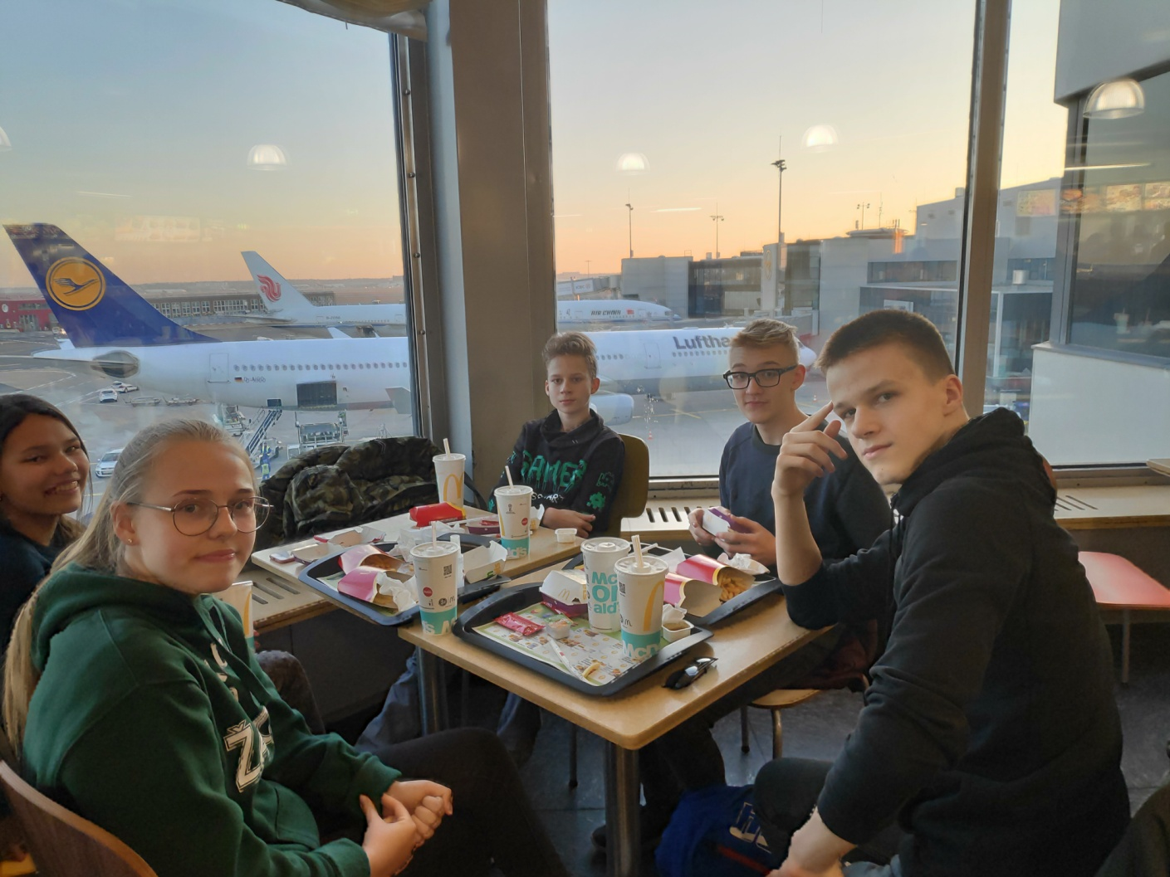
Day 1, February, 16
Saturday
The first stop : Frankfurt Airport

Slide 5
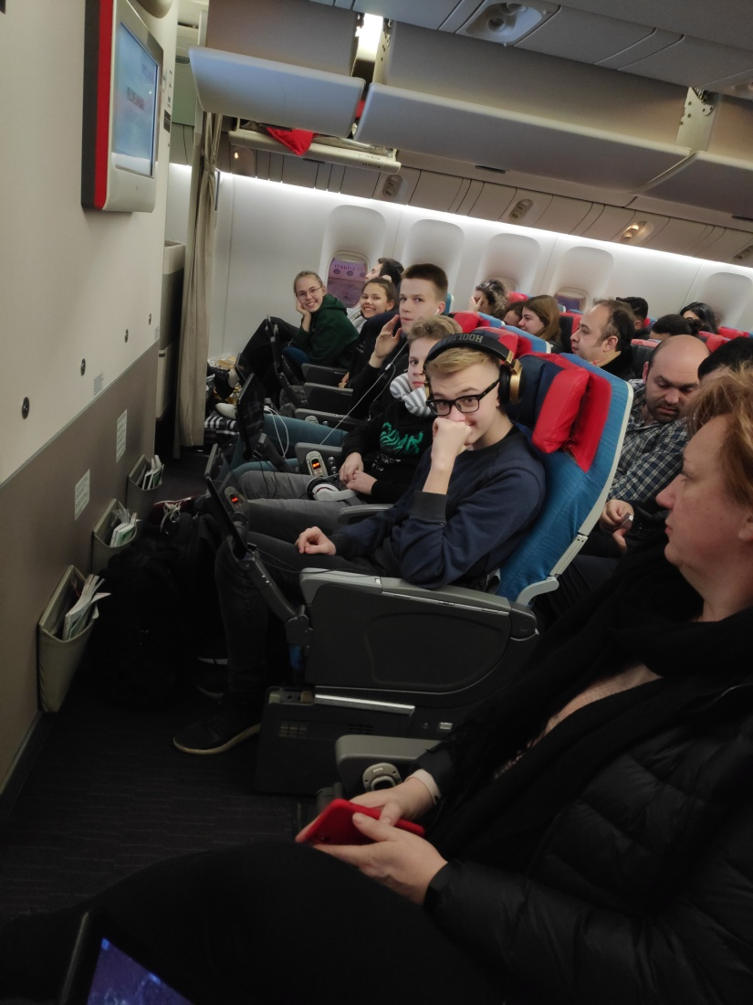
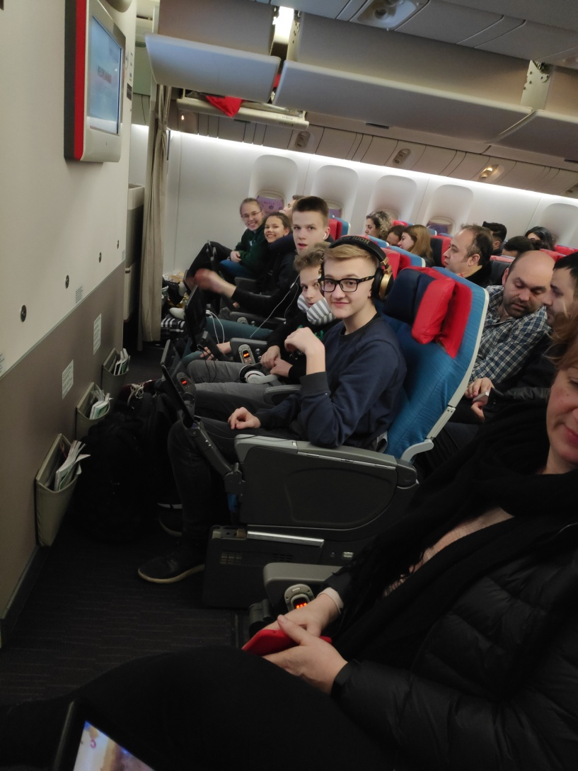
Sunday morning, 17,February

Slide 6
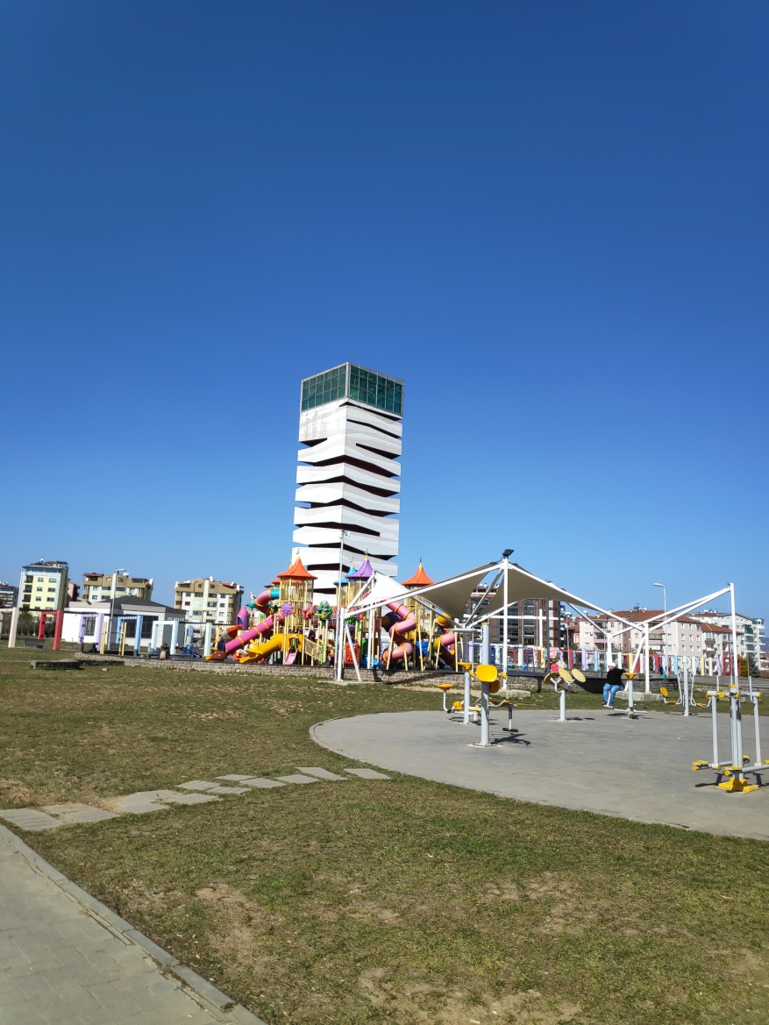
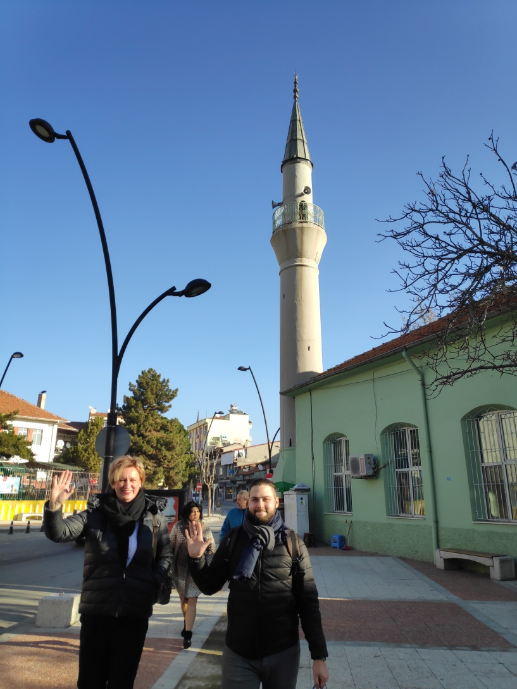
USAK

Slide 7
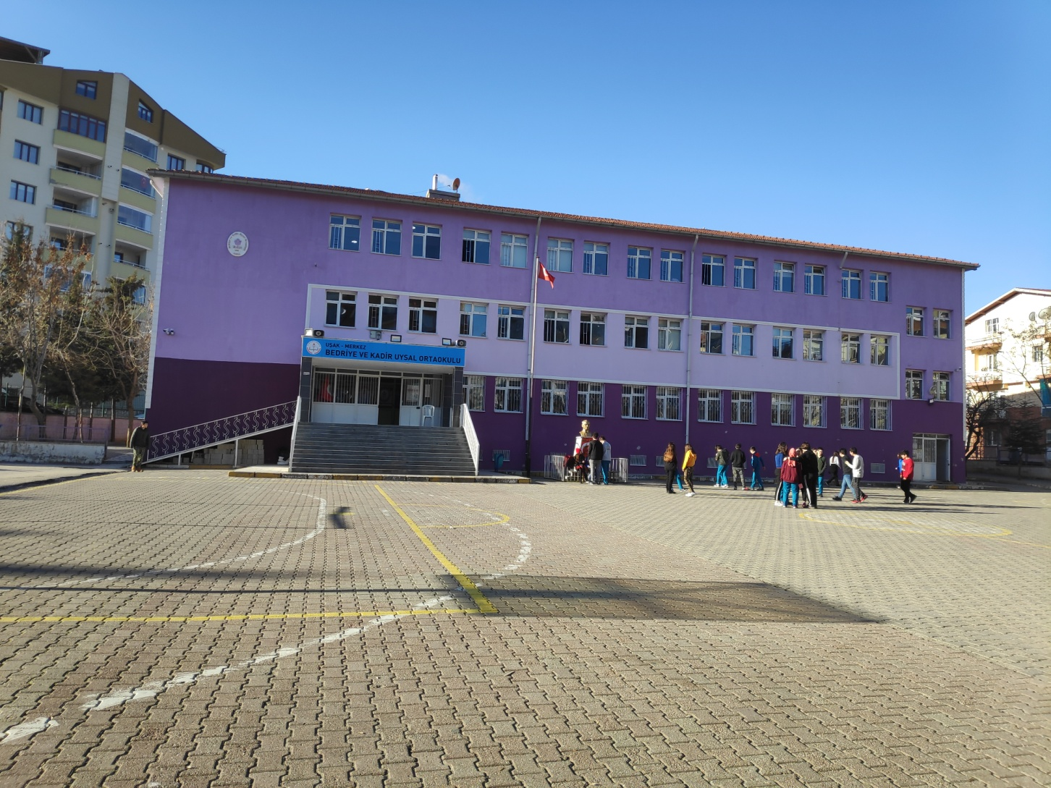
School building , Bedriye ve Kadir Uysal Ortaokulu

Slide 8
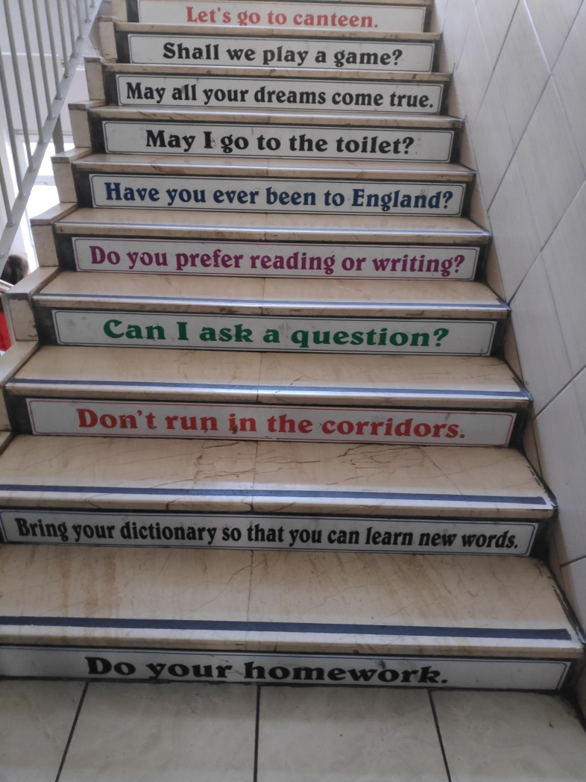
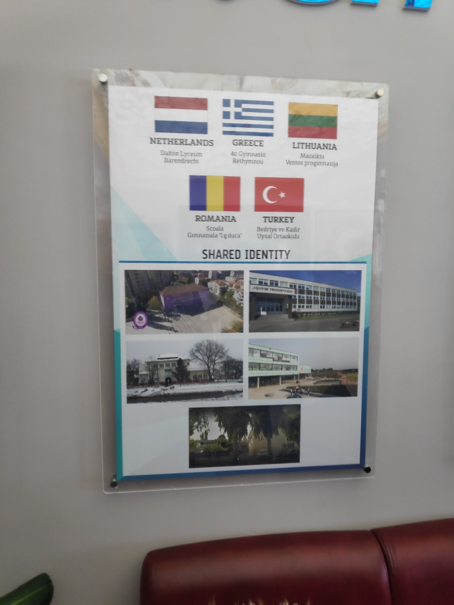
School

Slide 9
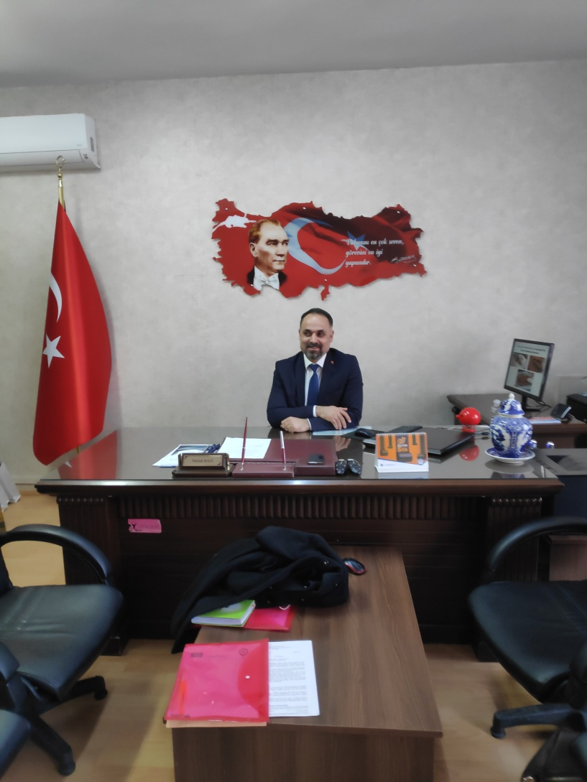
Headmaster in his office

Slide 10
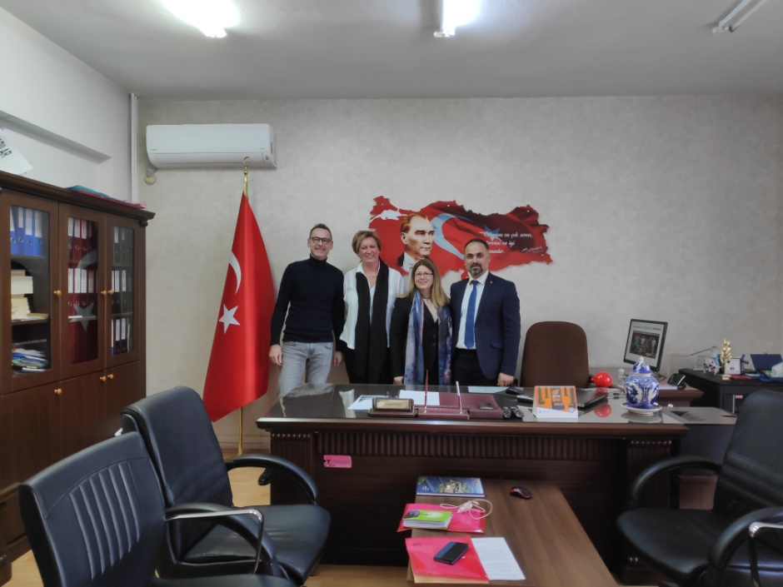
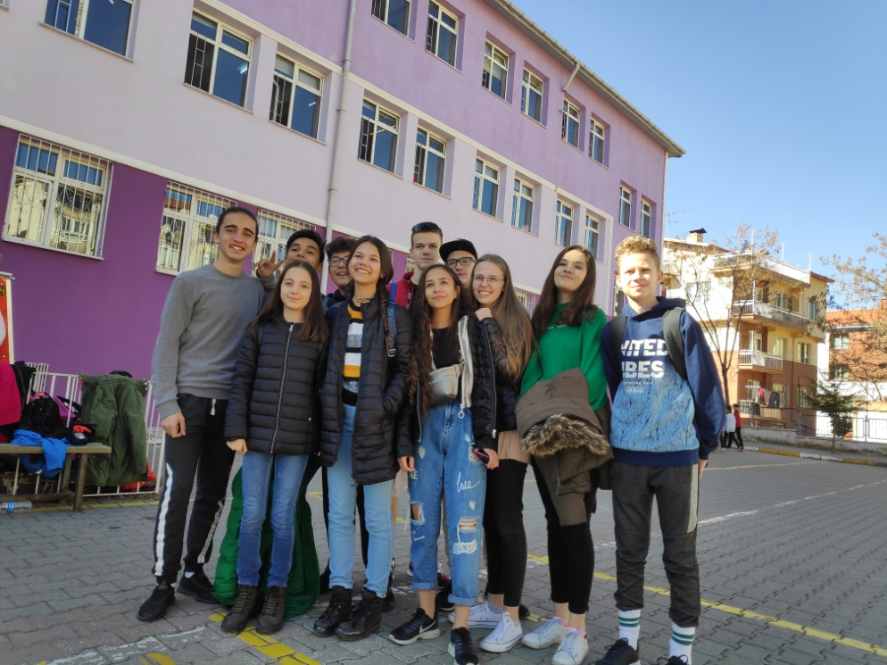
School

Slide 11
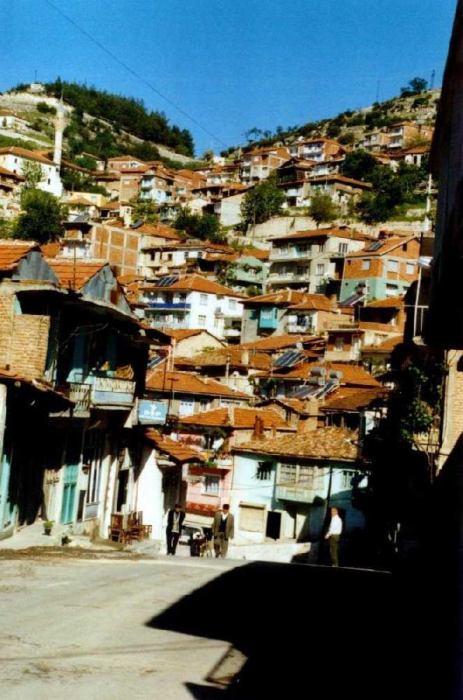
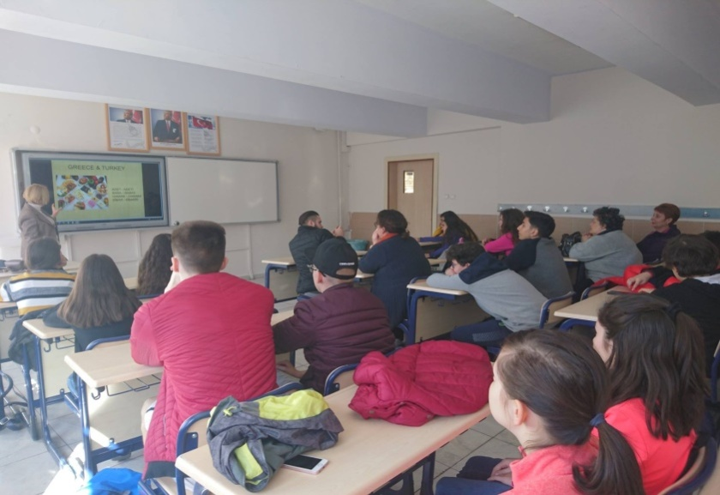
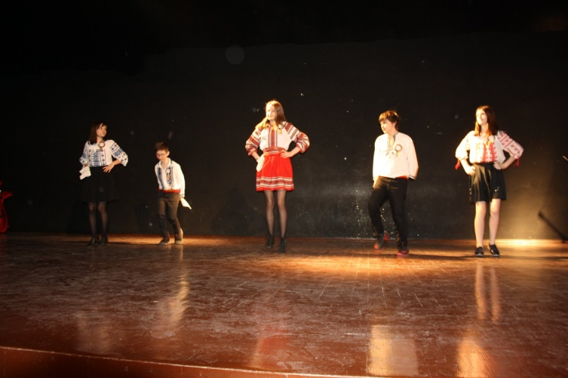
Welcome program
Monday

Slide 12
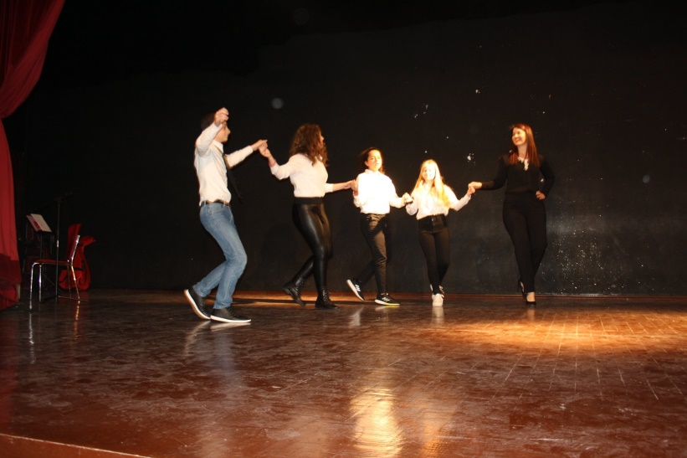
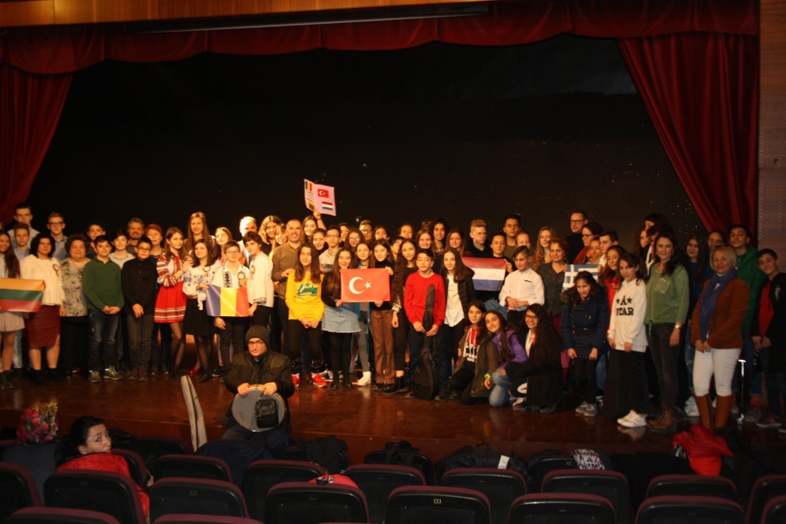
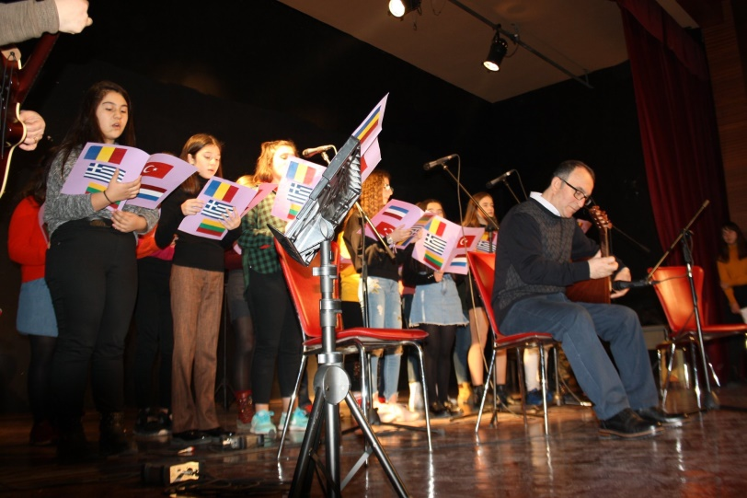
Country Presentations
The countries present their cities and schools

Slide 13
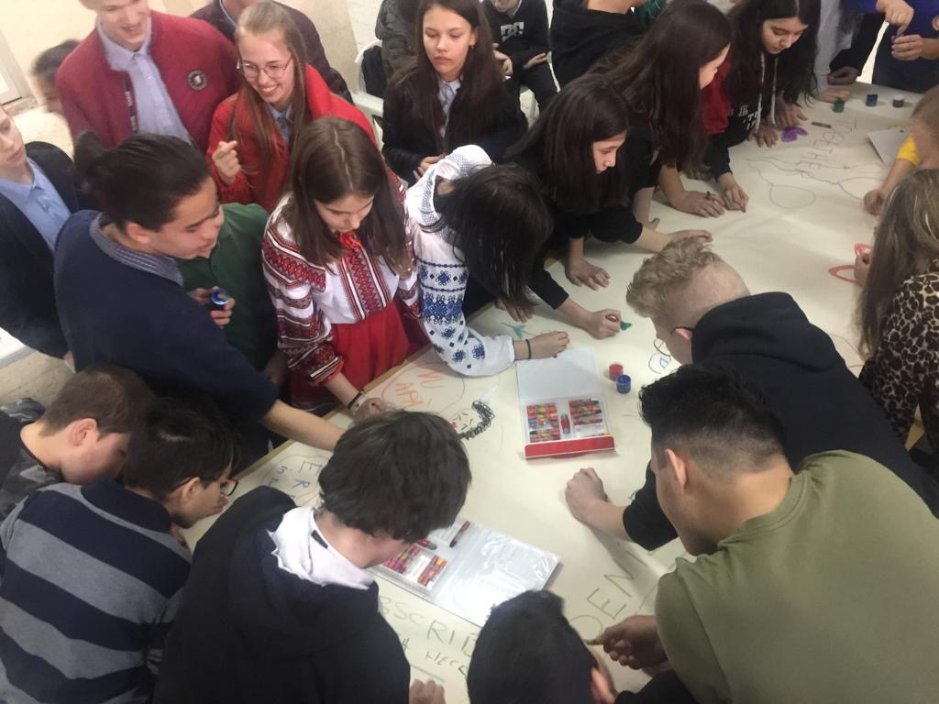
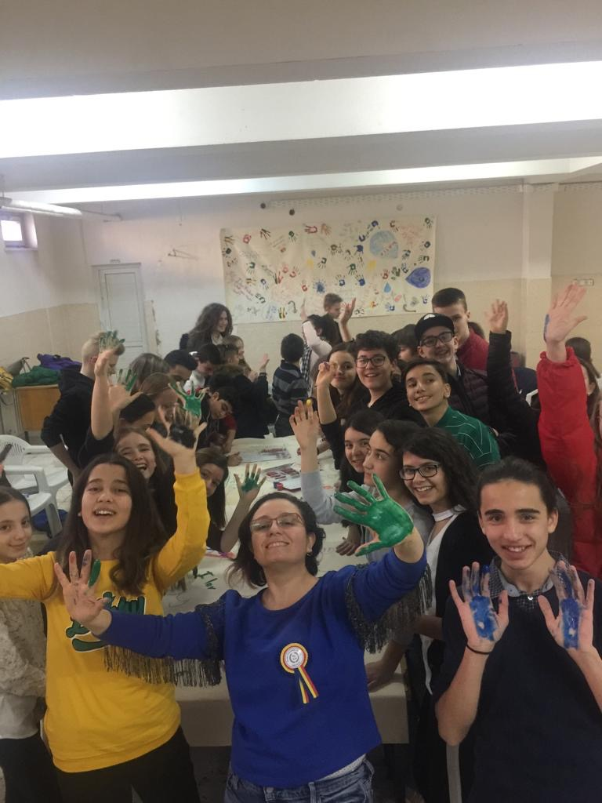
Art workshop
Spend time together

Slide 14
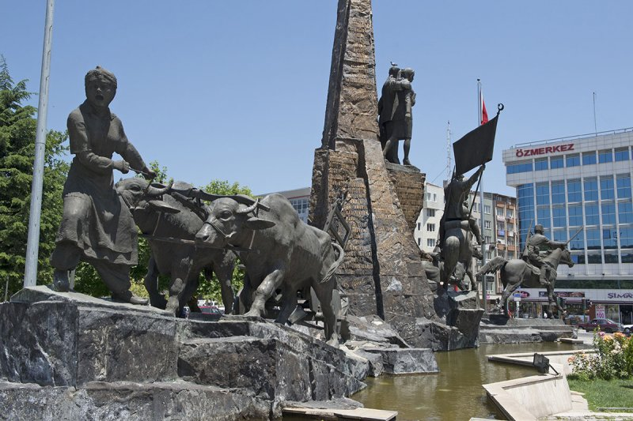
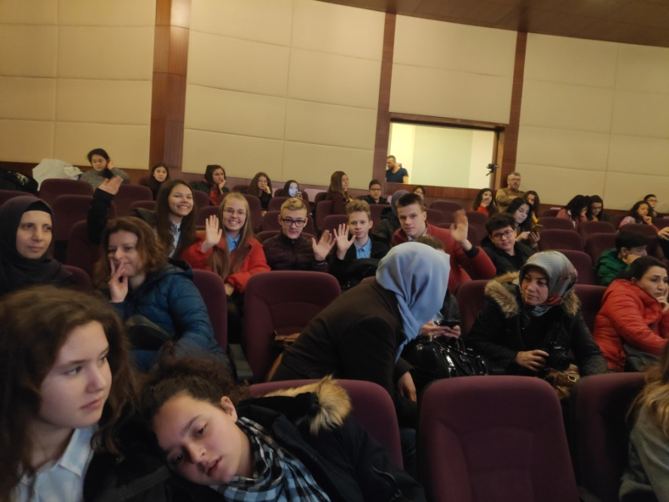
Leisure time

Slide 15
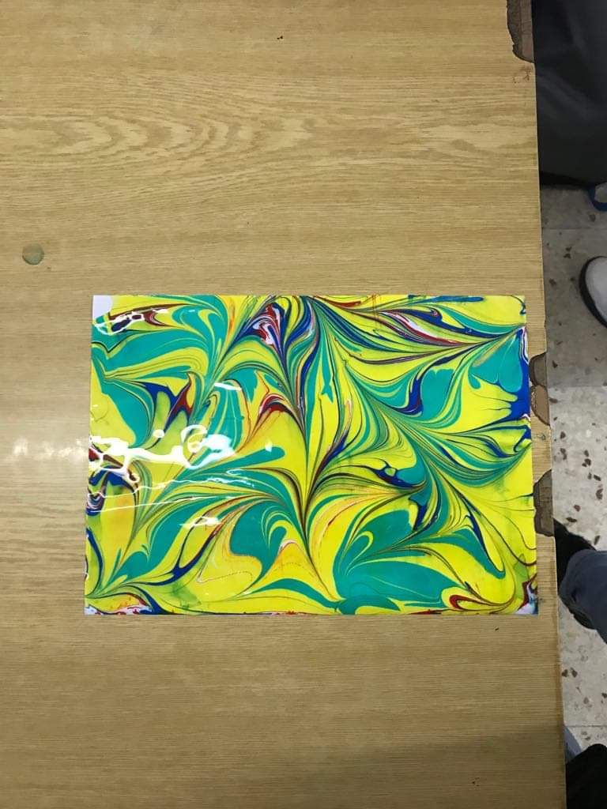
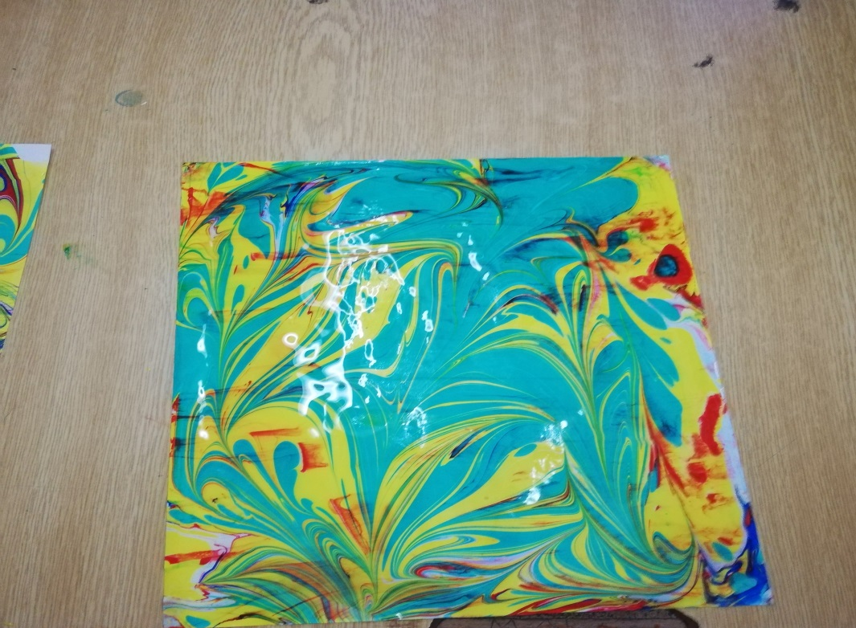
Tuesday
Tuesday‘s trip started in Usak‘s local school, where we painted on water/Ebru

Slide 16
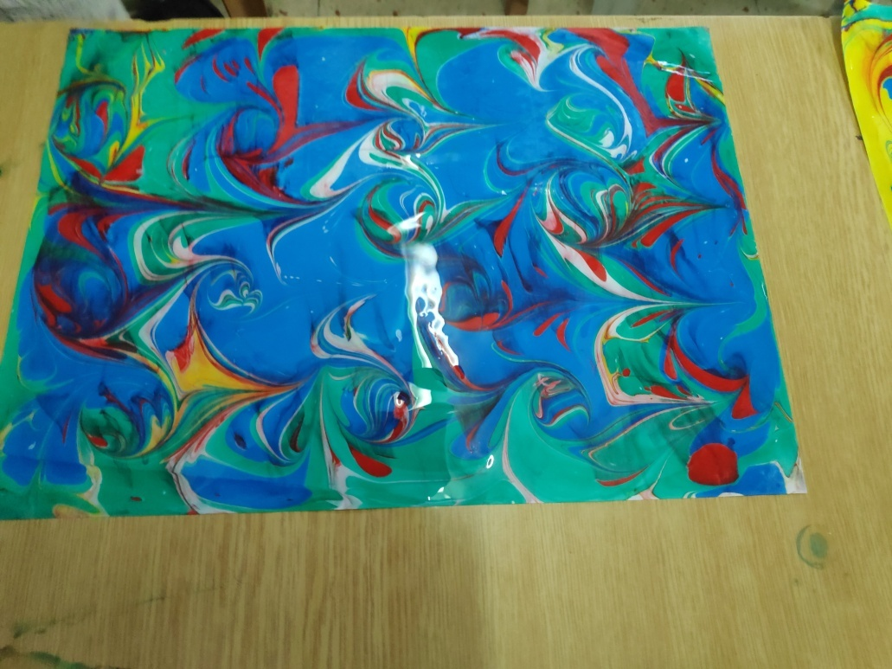
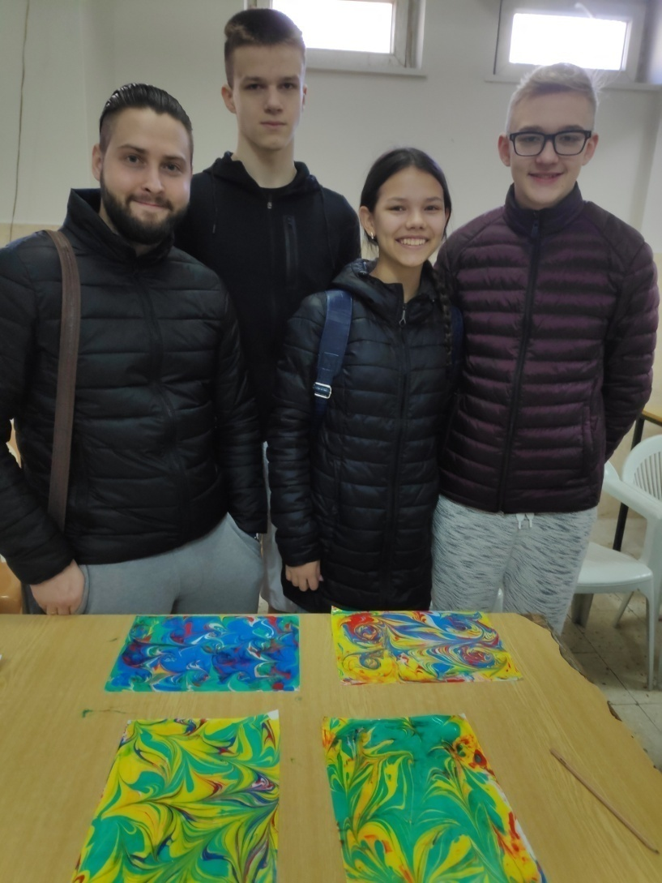
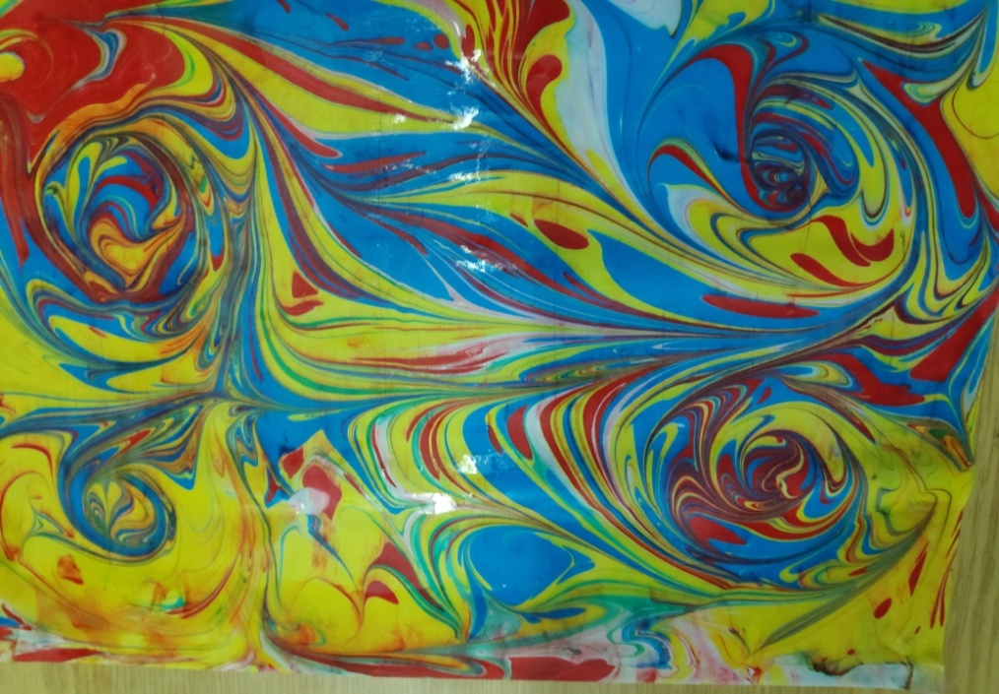

Slide 17
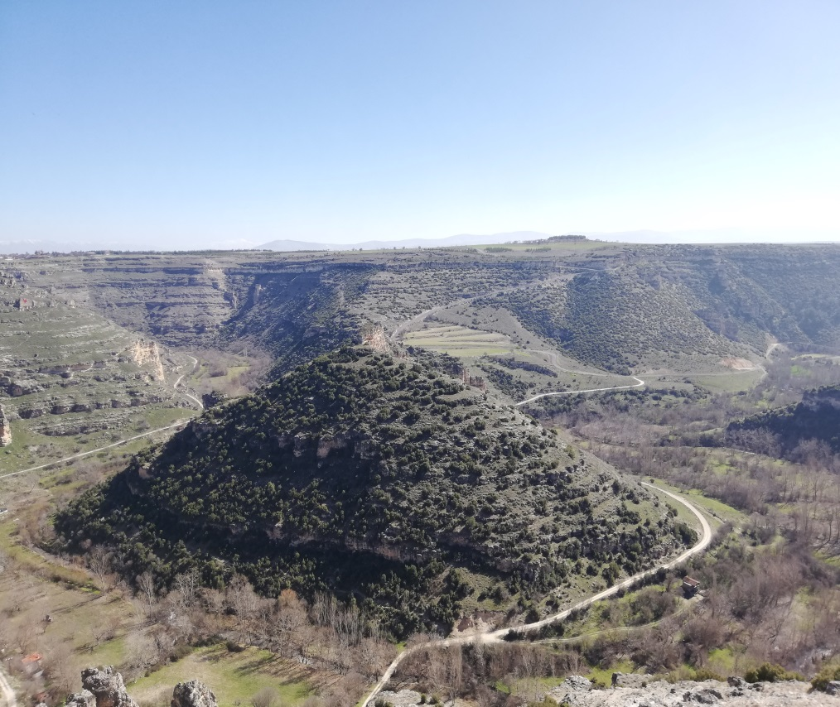
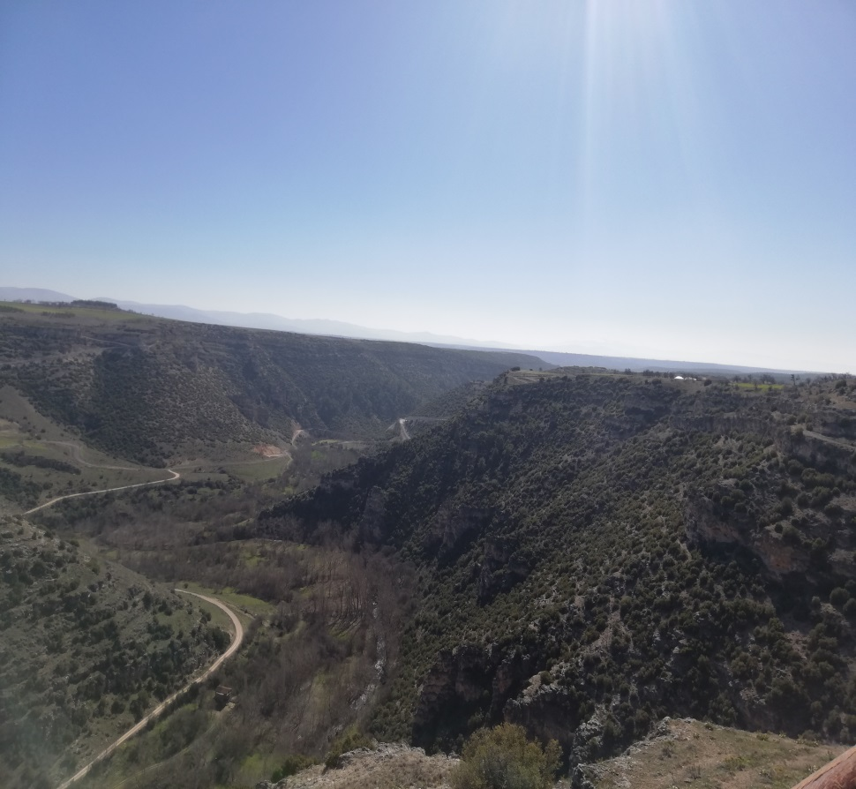
Canyons
Before midday we were by one of the natural treasures of Turkey, the Canyons.

Slide 18
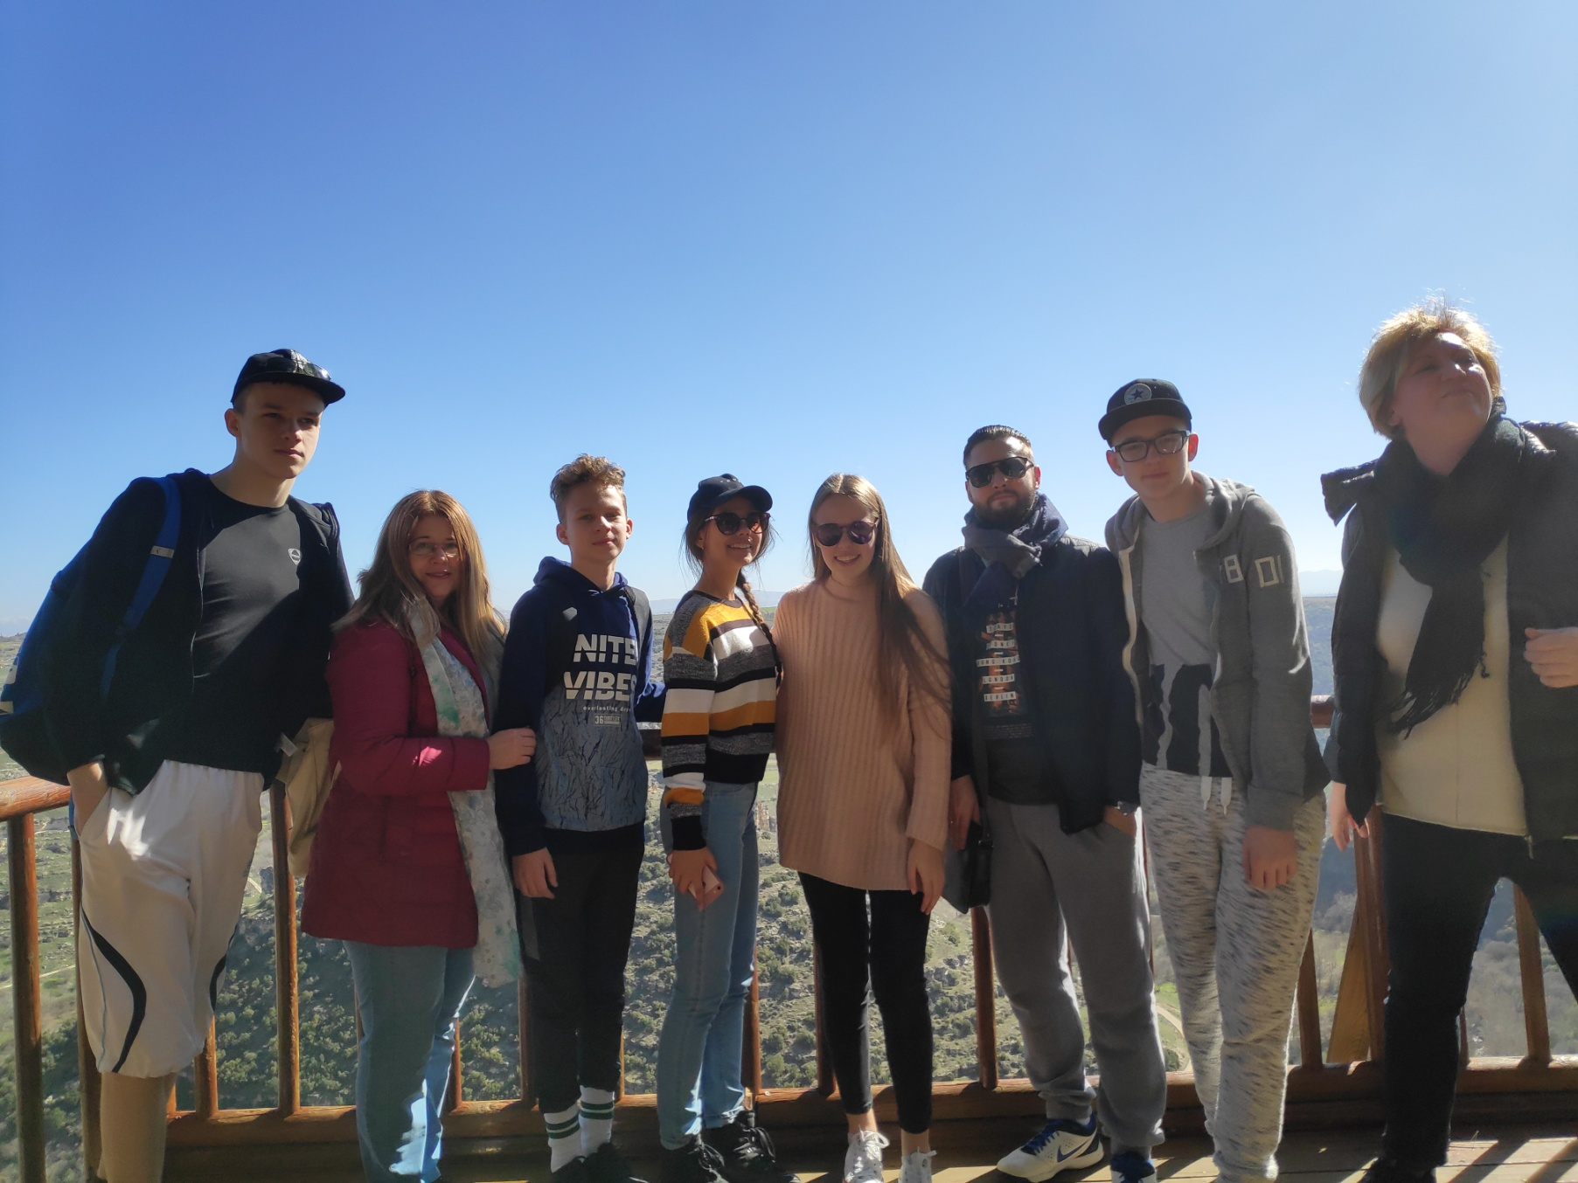

Slide 19
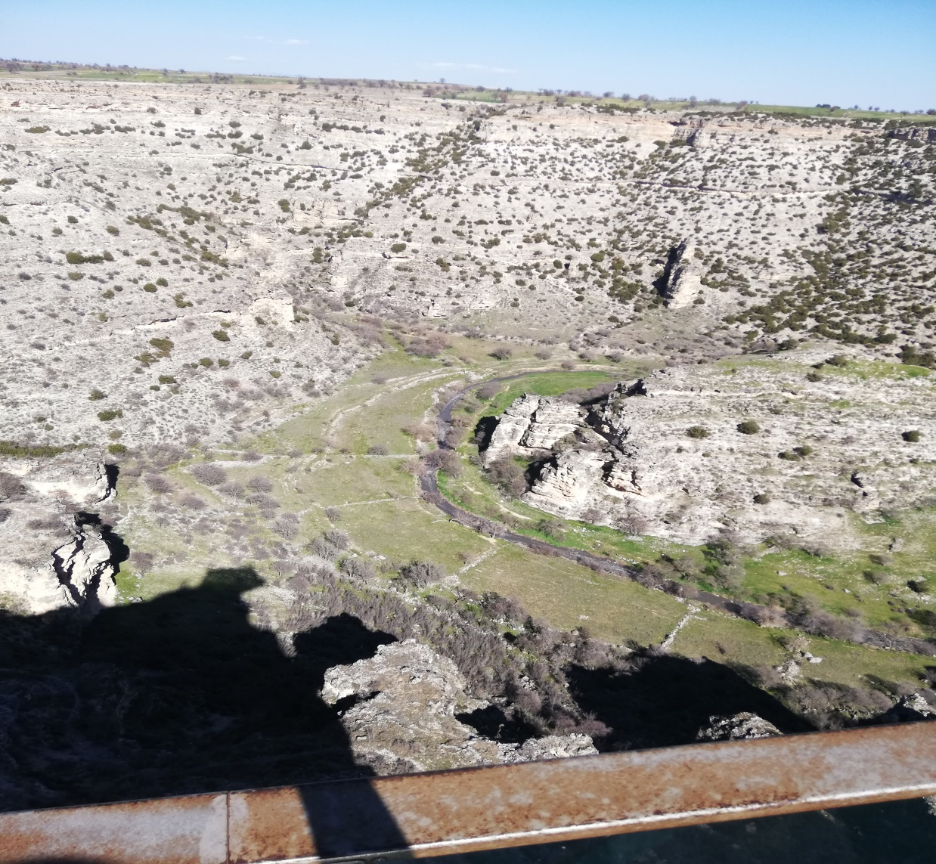
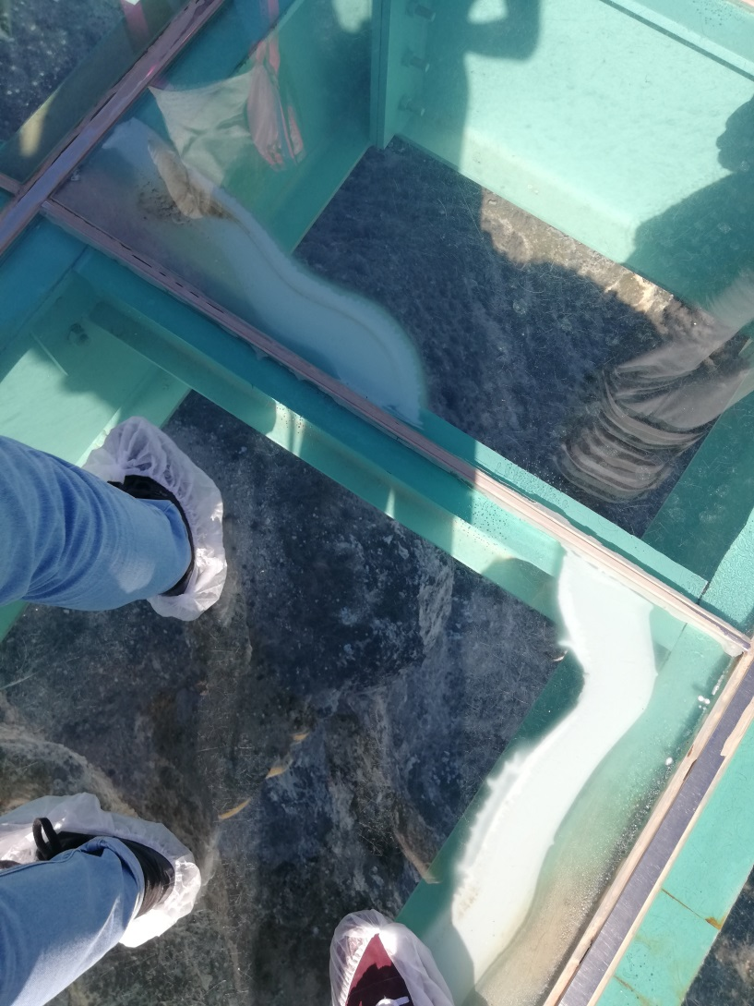

Slide 20
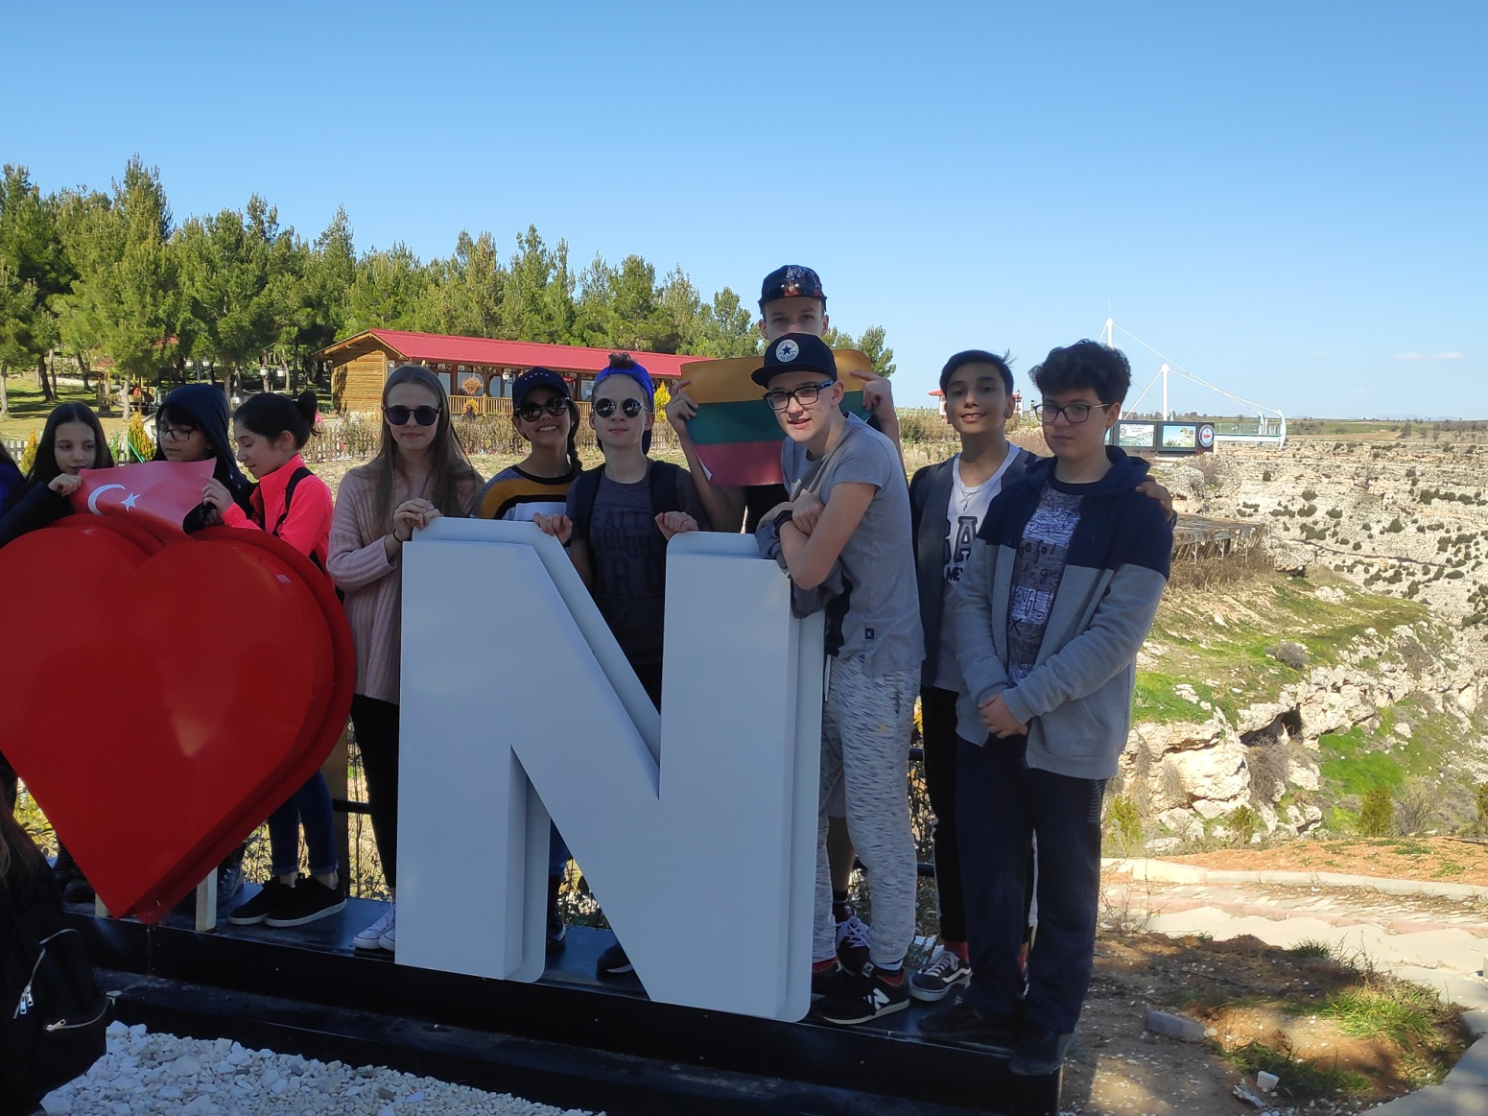
Canyon

Slide 21
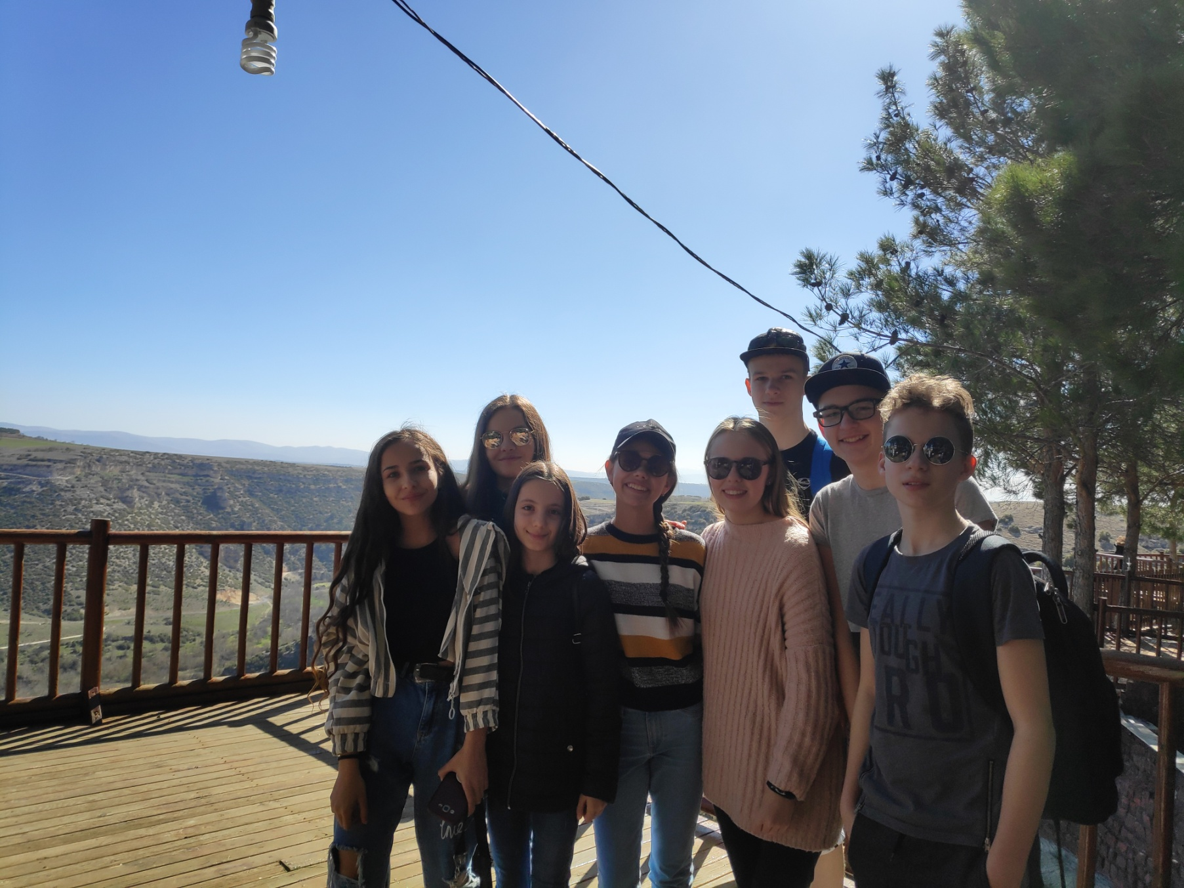

Slide 22
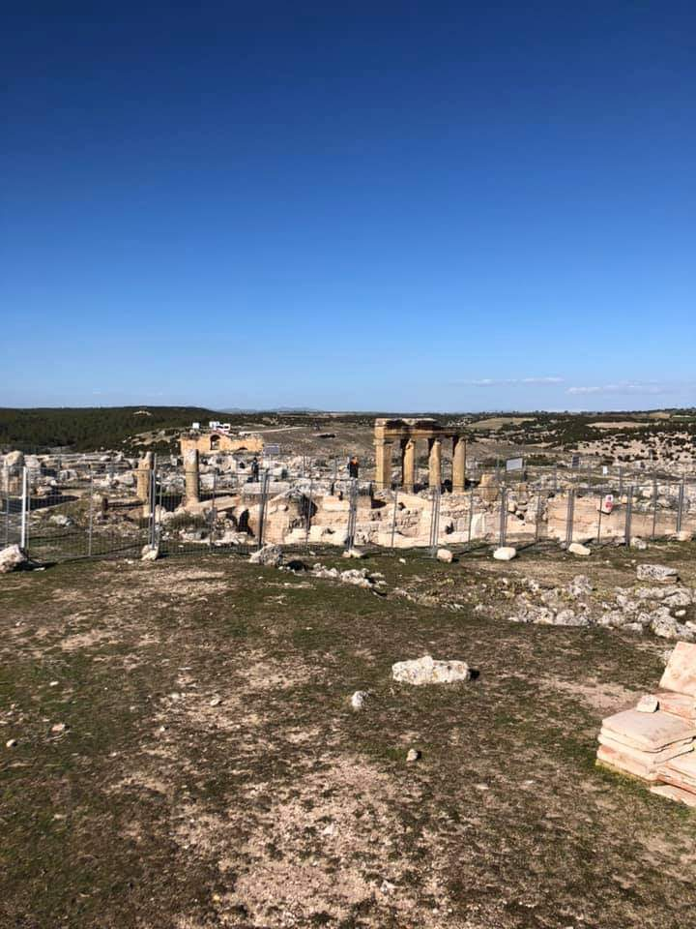
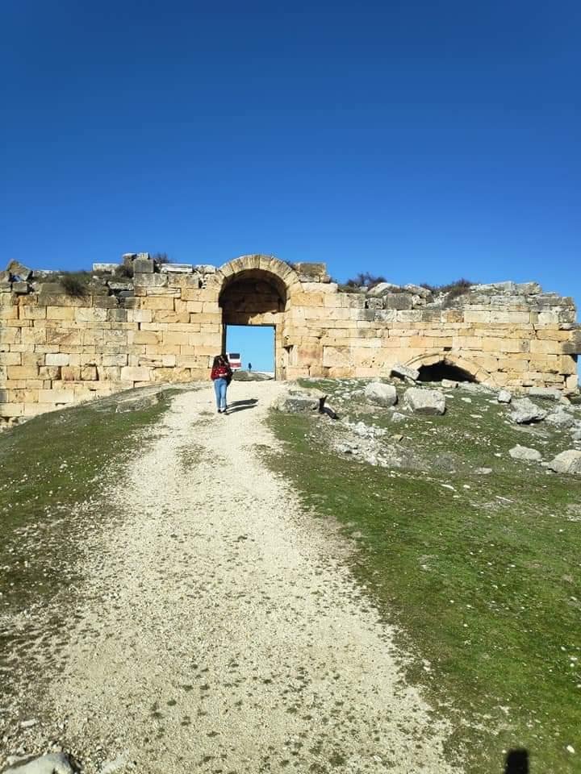
Blaundus
After an amazing walk around the Canyons, we travelled to the ruins of an ancient city called Blaundus.

Slide 23
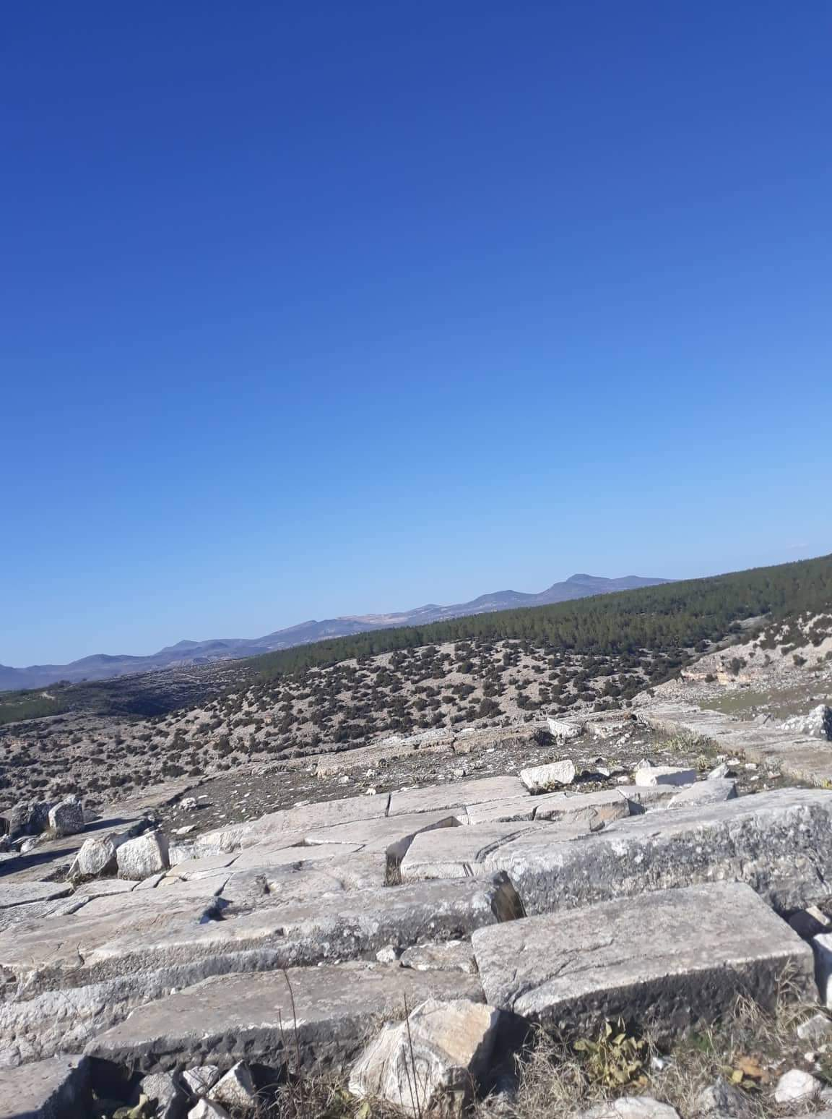
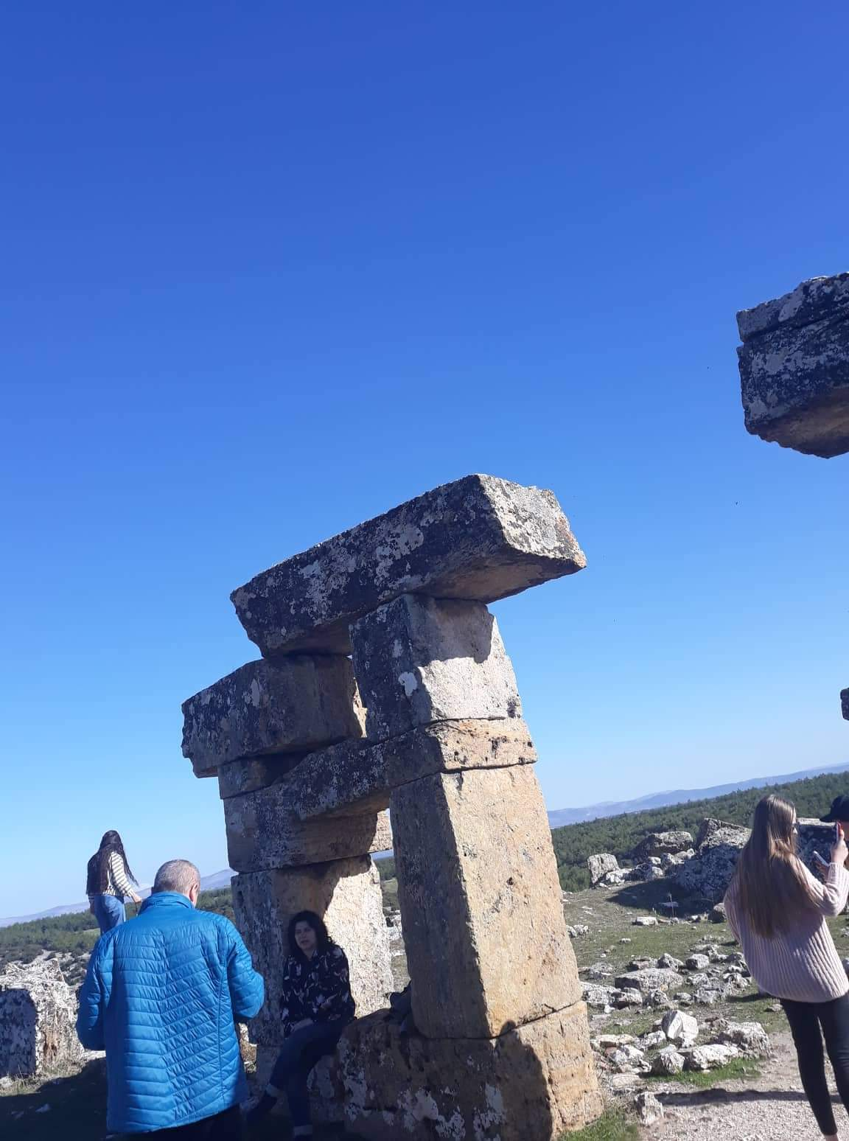

Slide 24
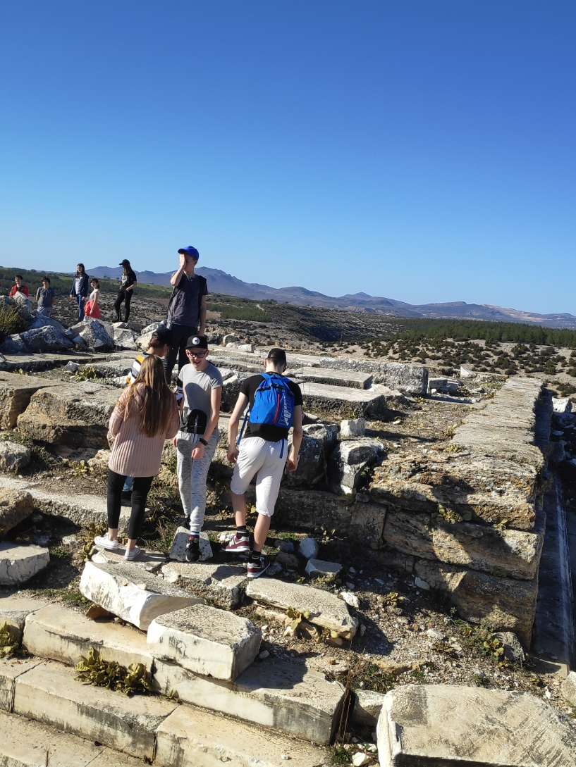
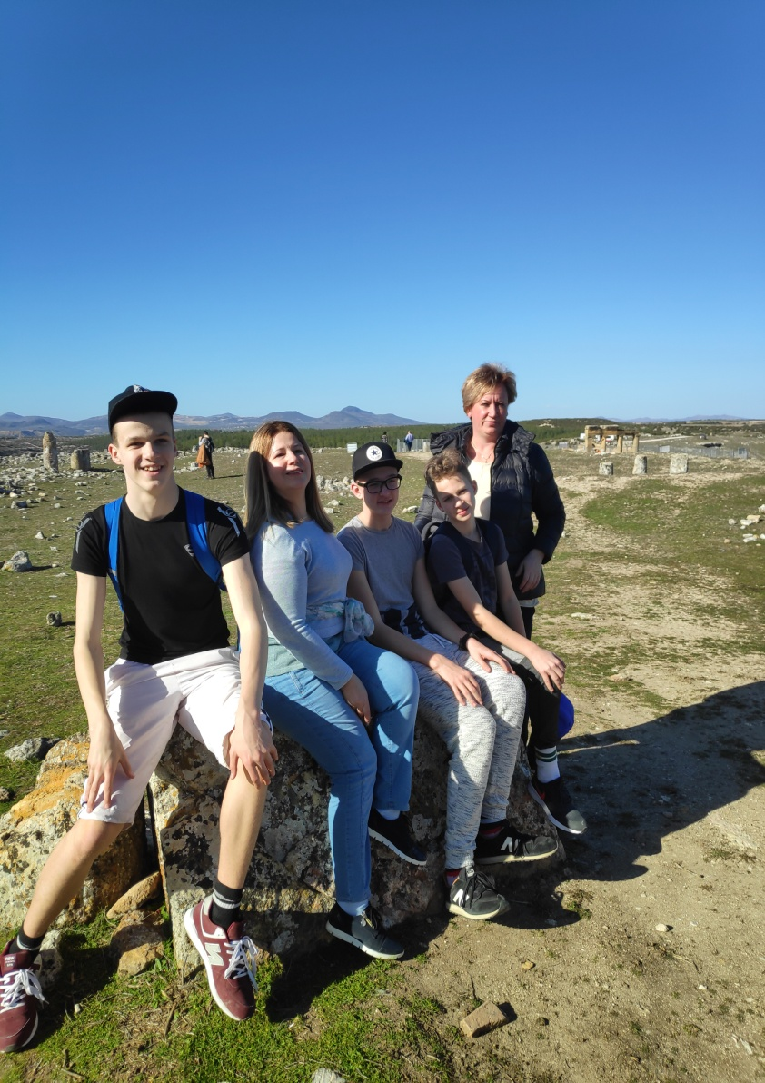
BLAUNDUS

Slide 25
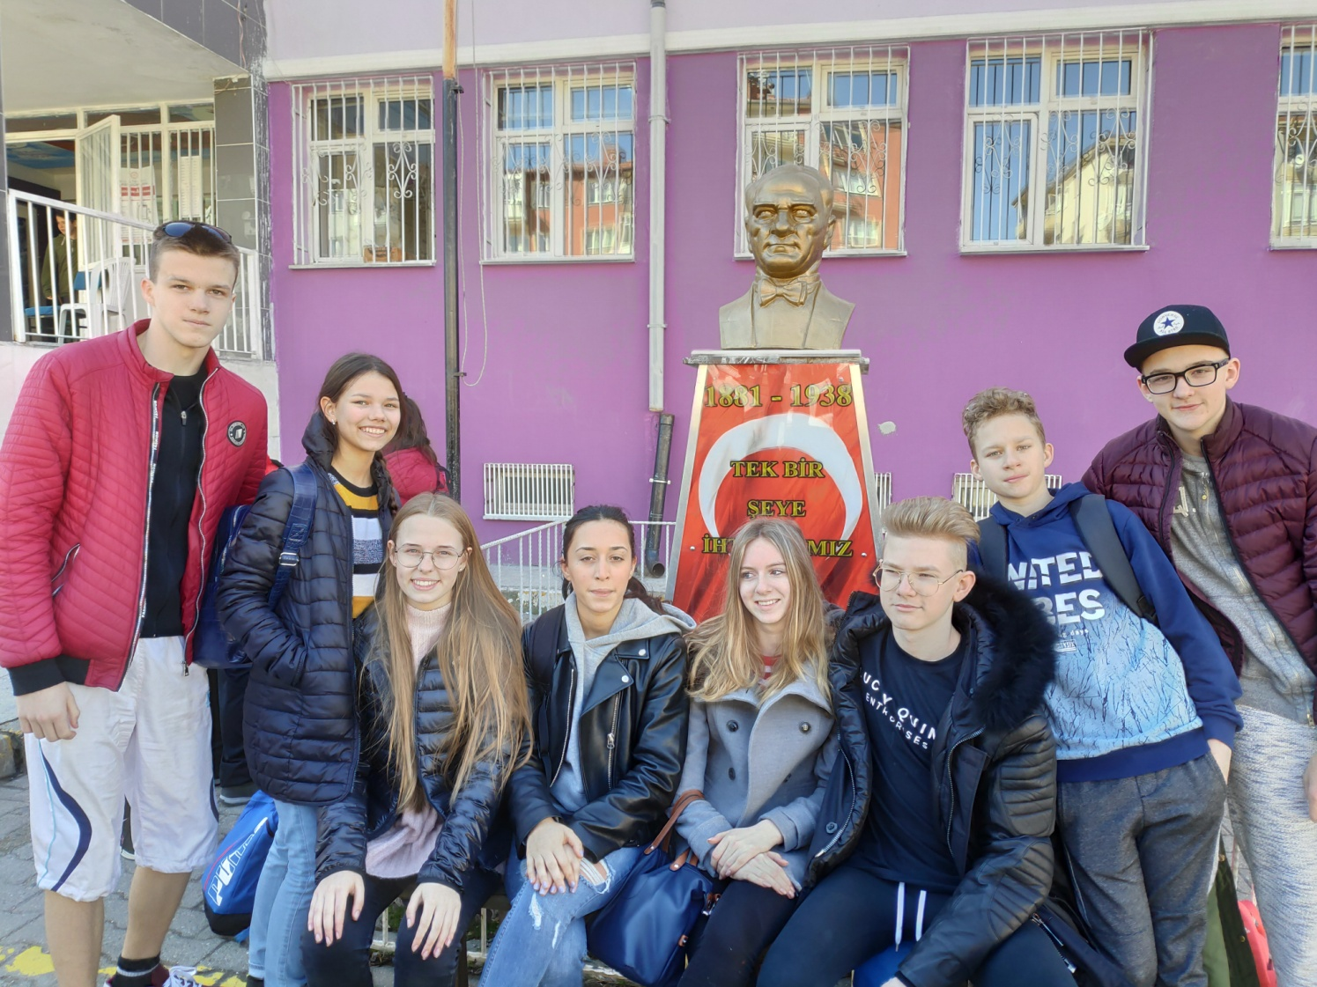
Wednesday

Slide 26
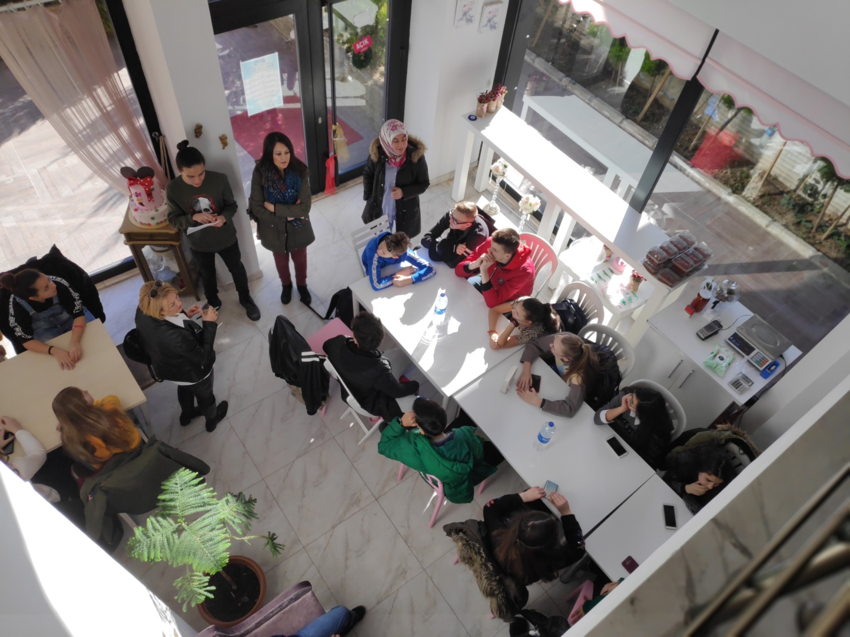
In the morning we went to make traditional Turkish meals

Slide 27
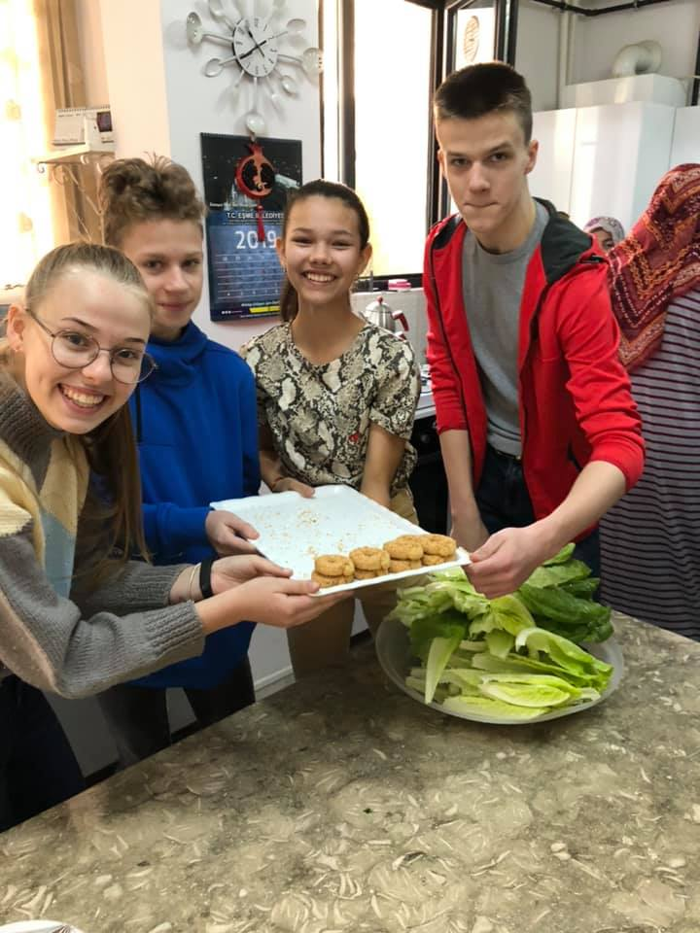
Enjoy your meals

Slide 28
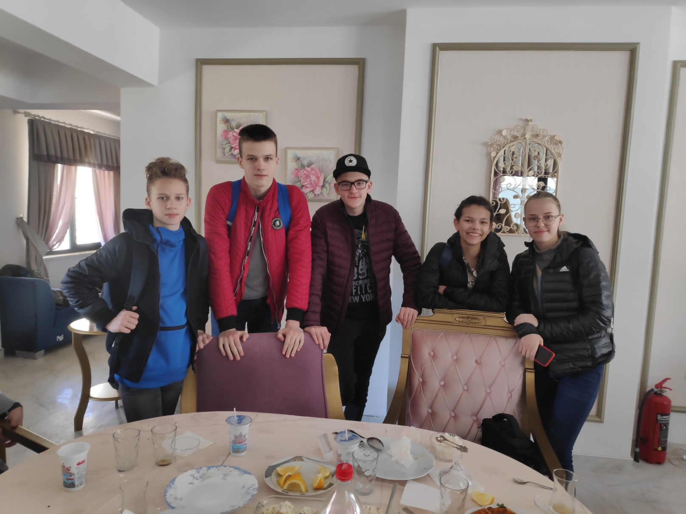
After lunch

Slide 29
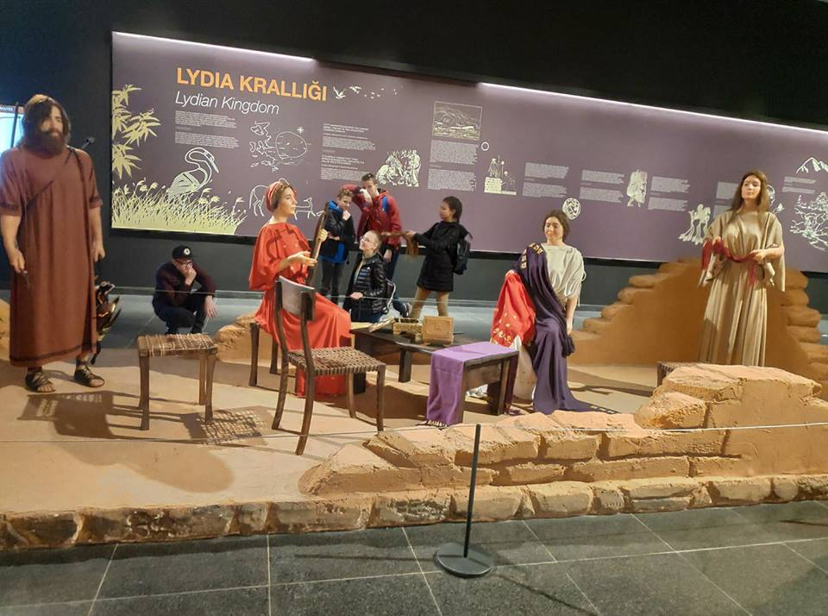
After eating we went on a city tour where we went to the museum where we learned a little bit about the history of Uşak and Turkey

Slide 30
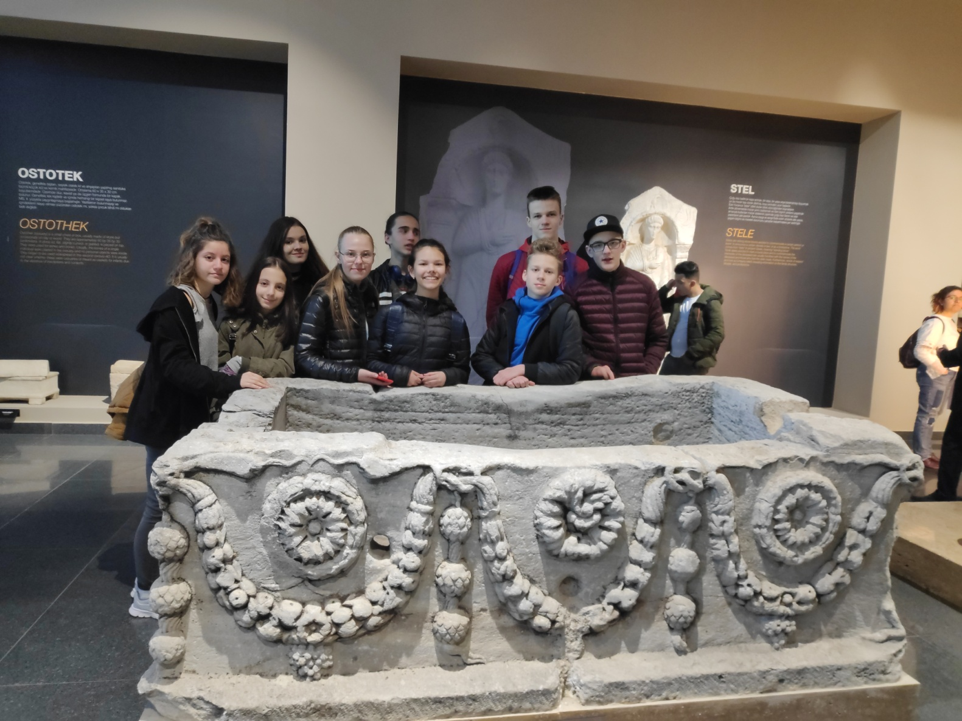
At the museum

Slide 31
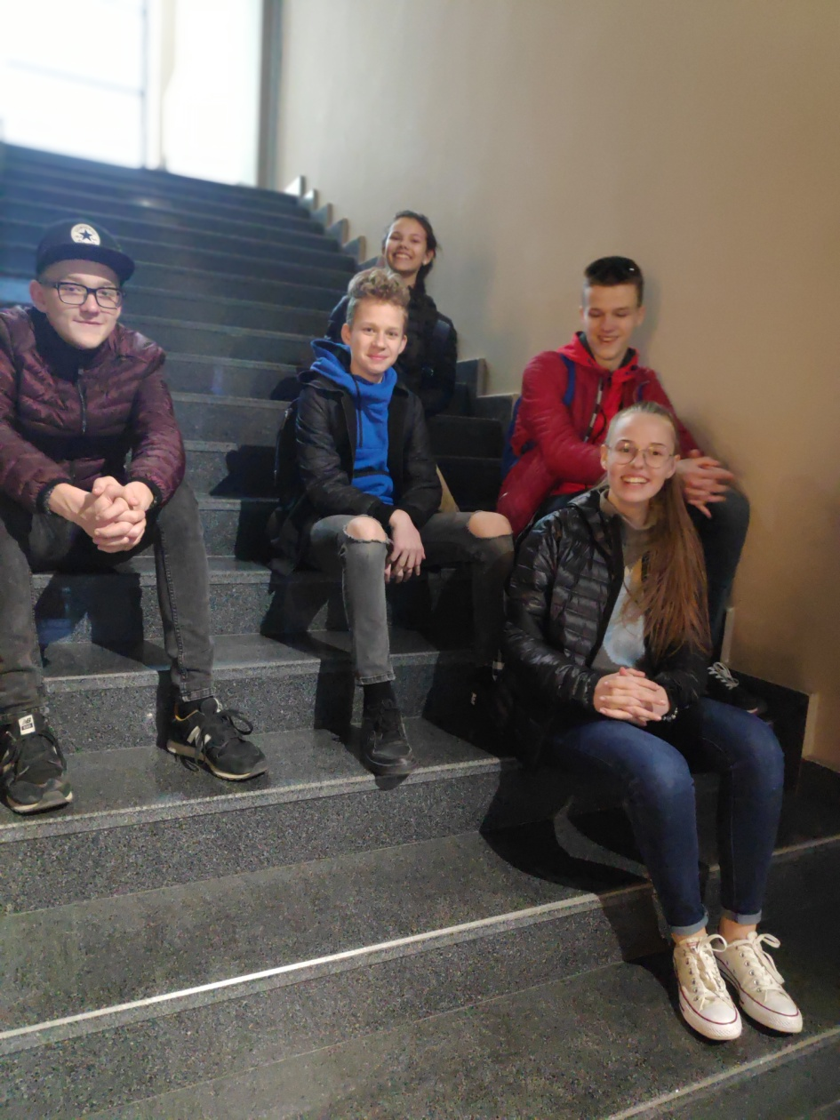
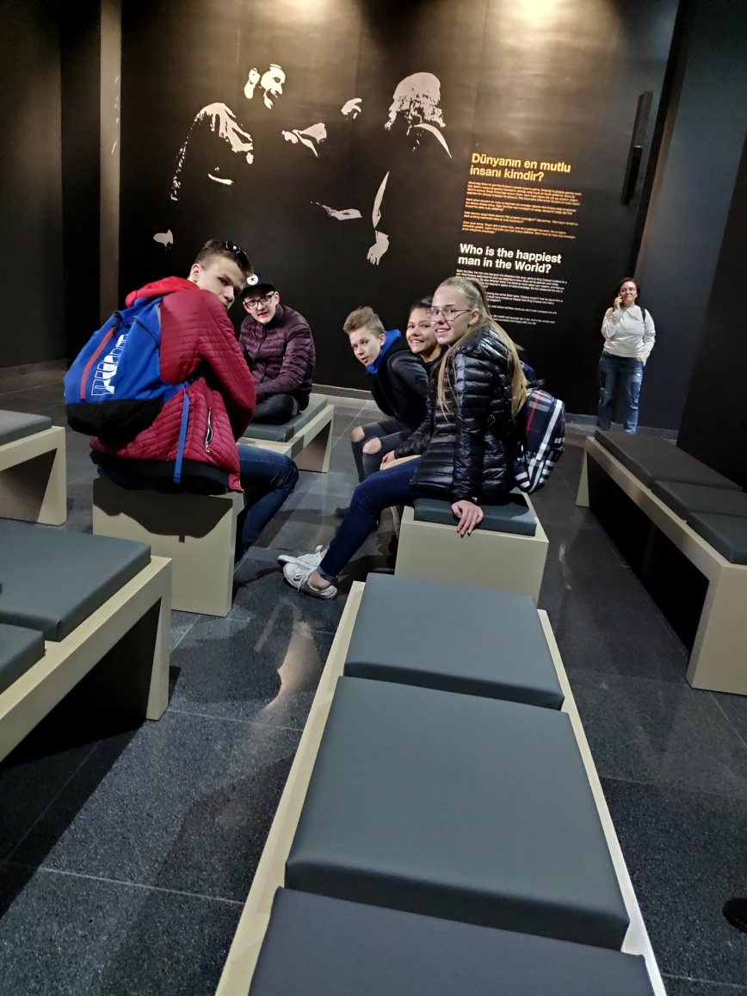

Slide 32
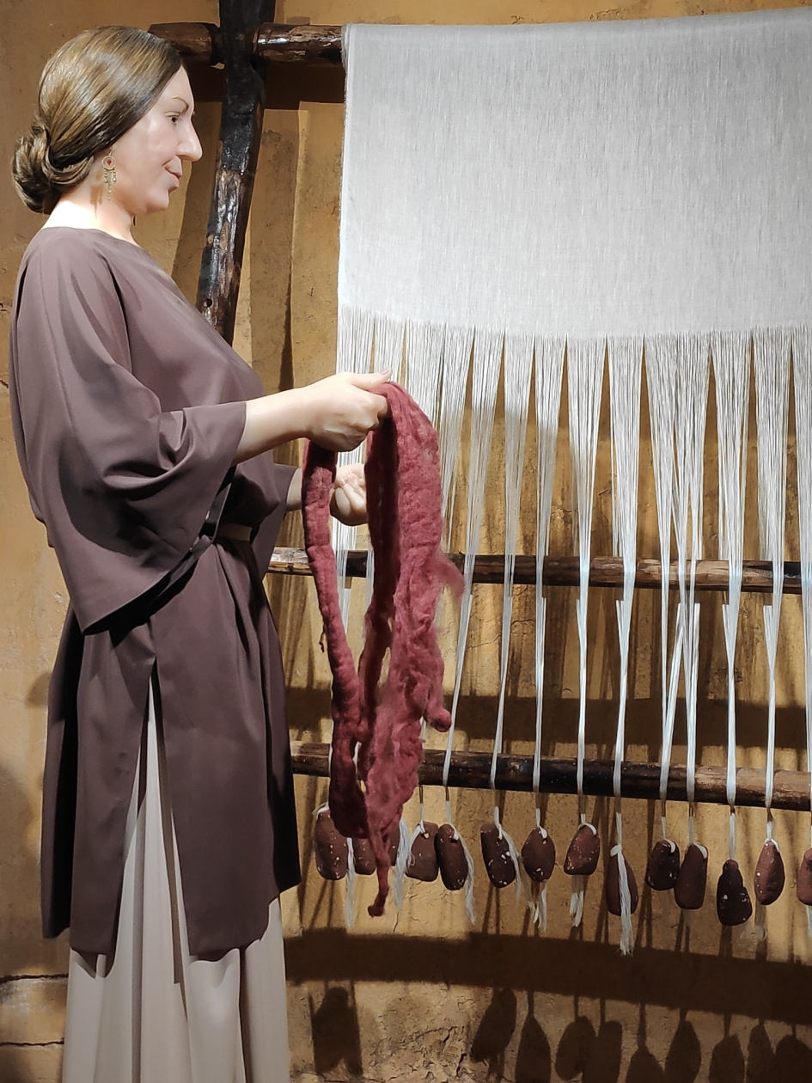
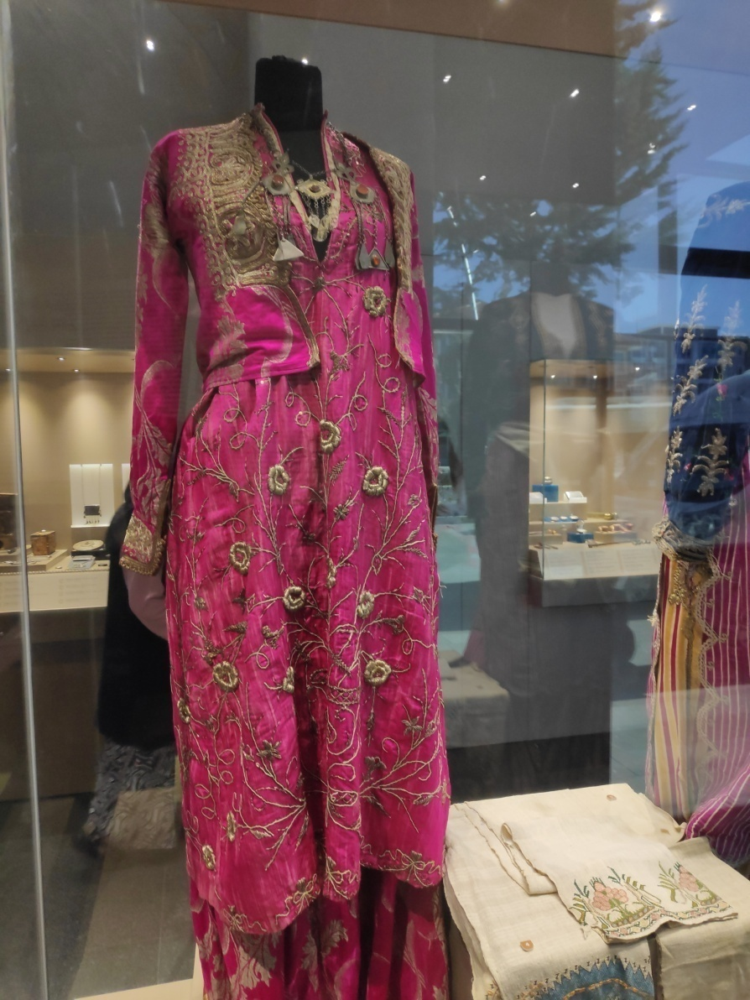

Slide 33
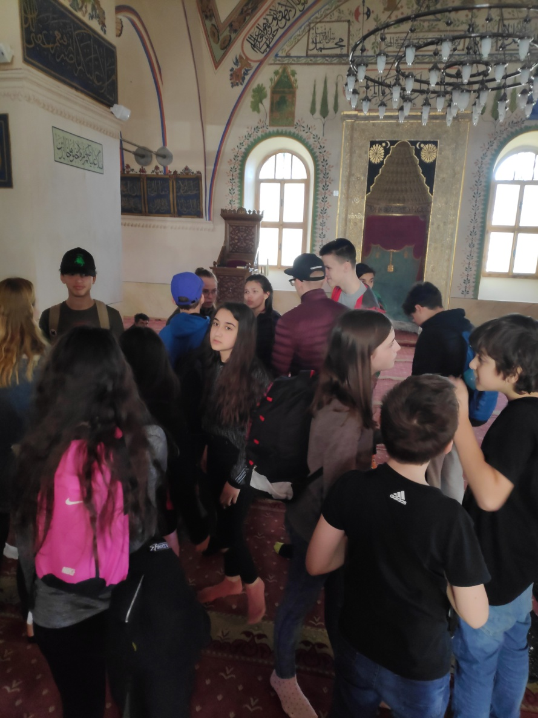
And at the end we visited a mosque

Slide 34




Slide 35


Market

Slide 36



Pamukkale
Day 4 (Thursday)

Slide 37

The program
All day trip to Pamukkale started at 8:00
We stopped at Kaklik cave
Near Denizli city we had a look at Ancient Necropolis and we could walk around it
After that we arrived at Pamukkale
17:00 the program ended
Fun fact: when we were coming back to our homes, we saw
a fire!

Slide 38





Kaklik
A sort of underground Pamukkale, this cave gushes with calcium- and sulphur- rich water.

Slide 39





Ancient Necropolis

Slide 40





Pamukkale (I)
The view was stunning!

Slide 41




Pamukkale (II)
We had an opportunity to swim in the swimming pool, which had antique columns.

Slide 42
Friday

Slide 43


Carpets
In the morning, we visited carpet making centre.
Those carpets cost around 1000 euros.
They are made monthly

Slide 44


Evaluation of the program
After lunch, we had evaluation of the program

Slide 45


Dinner with all groups in a Restaurant
(farewell dinner)
After a week of traveling, we had a farewell party with dances and songs

Slide 46


Farewell party: traditional dishes

Slide 47


Dances

Slide 48


When someone’s is too tired

Slide 49

Saturday, 23 February

Slide 50


Good bye, Turkey, welcome home

Slide 51

Thanks for watching

