Slide 1
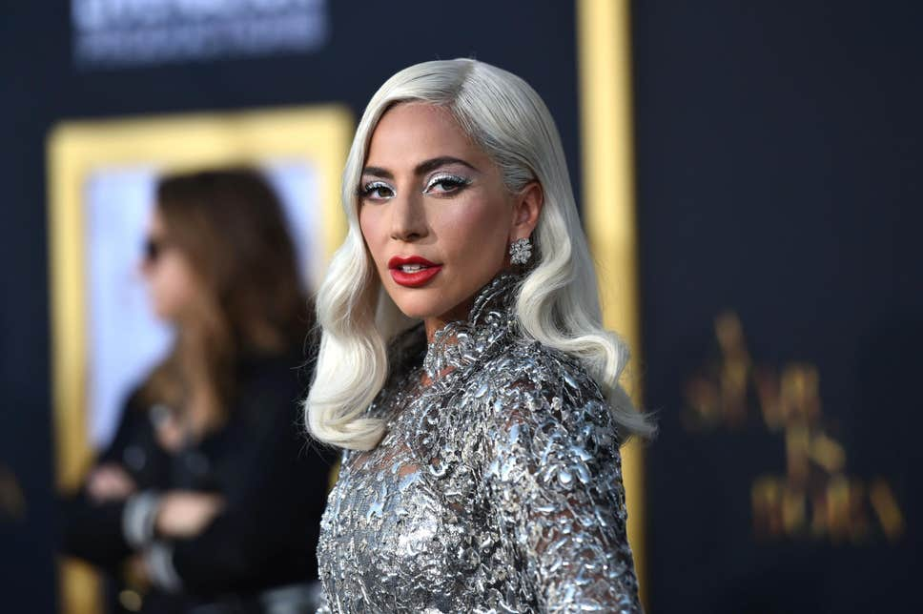
My favorite singer
Lady Gaga

Slide 2
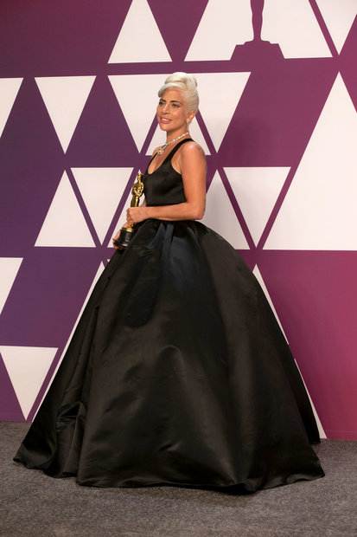
Biography
Lady Gaga is an American singer, songwriter and actress. She was born in 1986 in New York. She created her first song when she was 13. Her most popular albums: The Fame, Born This Way, A Star Is Born and Cheek to Cheek.

Slide 3
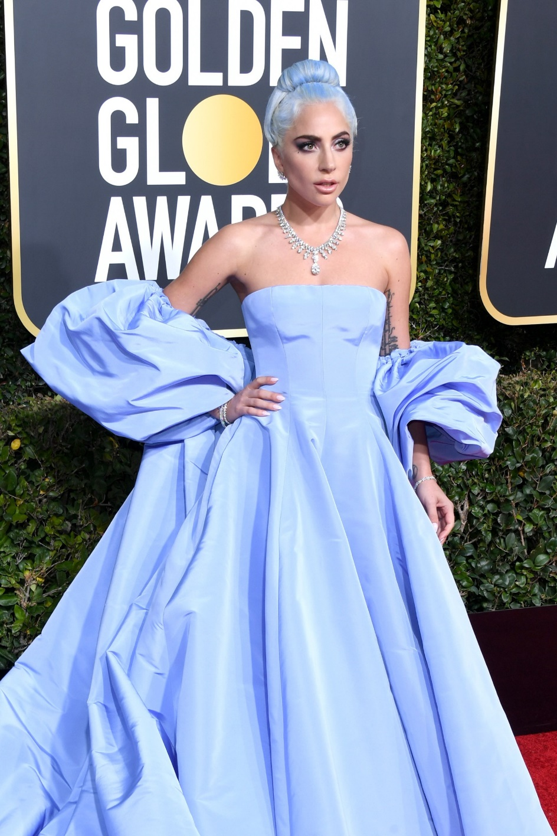
Career
Lady Gaga began performing as a teenager at open mic nights and acting in school plays. She studied at New York University.
Singer received a Golden Globe Award for best actress.

Slide 4
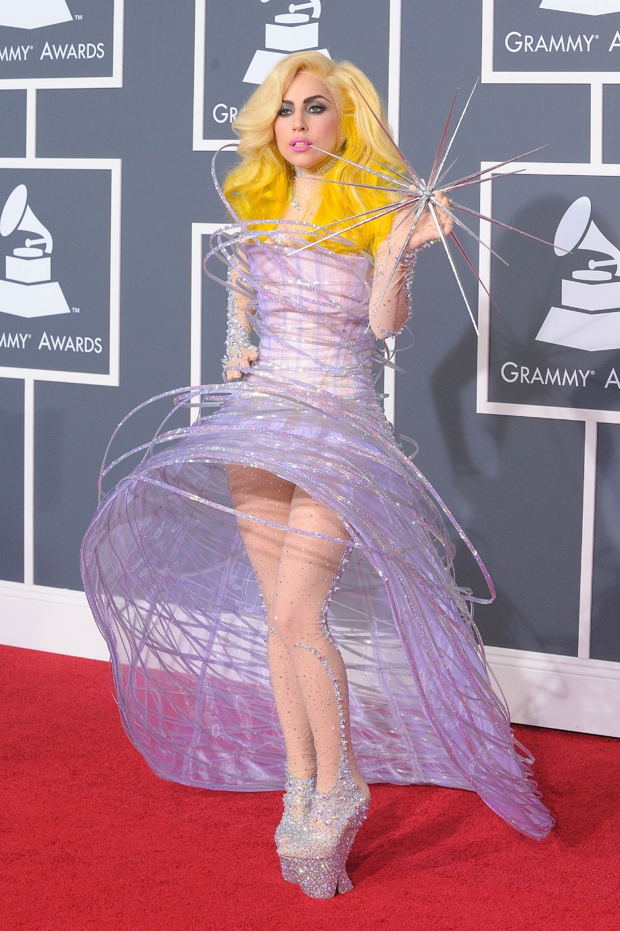
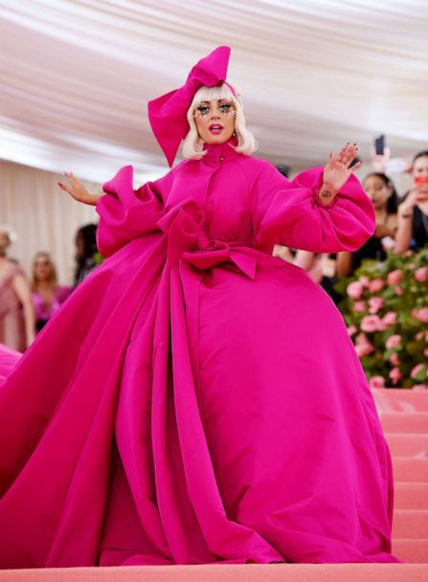
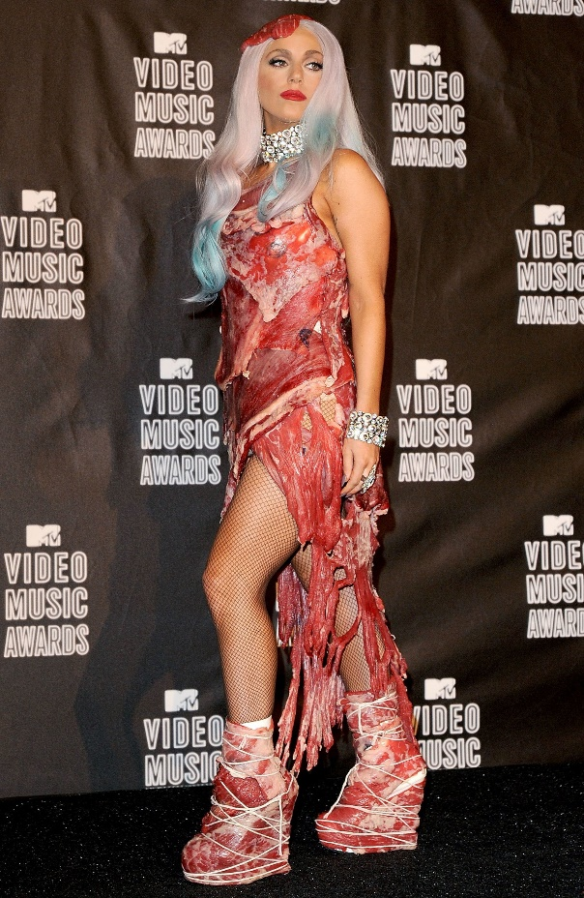
Style
Lady Gaga likes to wear unusual and crazy outfits.

Slide 5
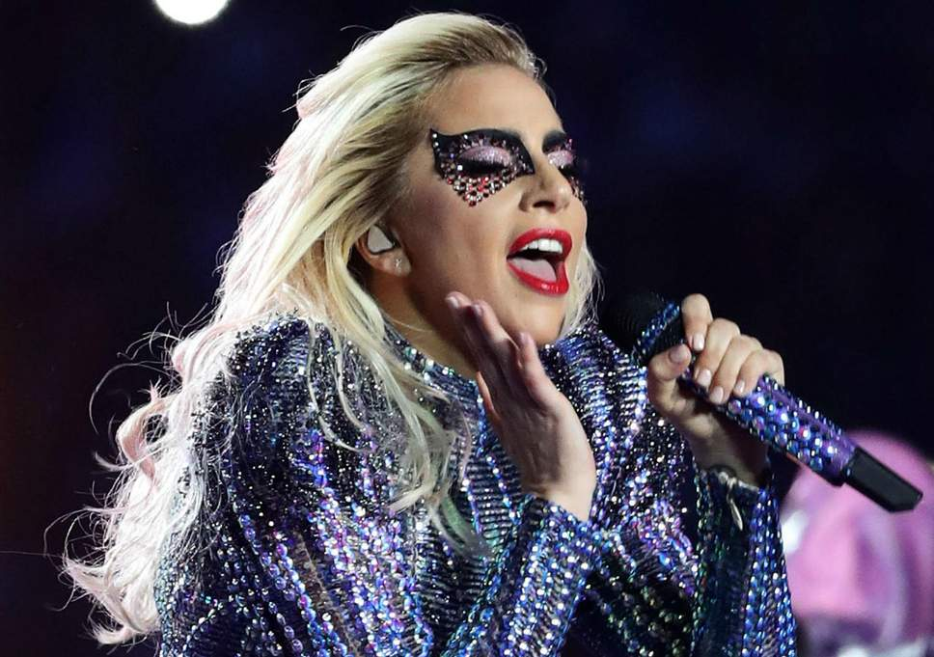
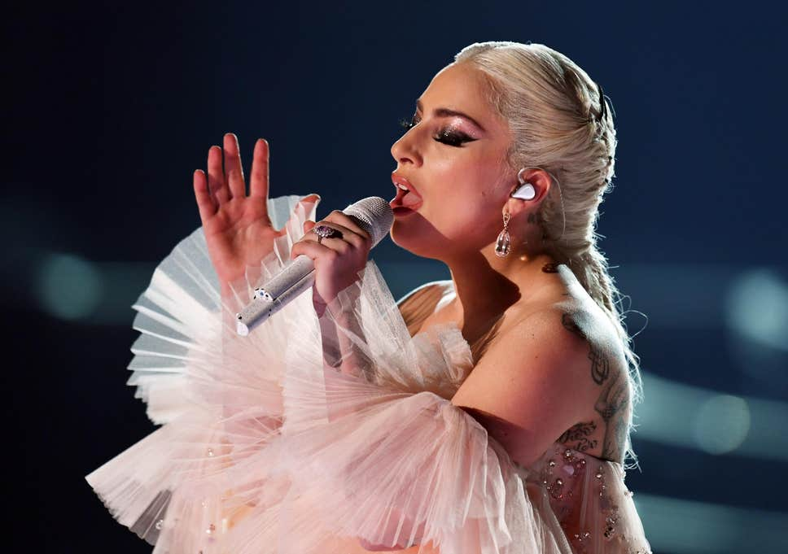
Why do I like her ?
I like Lady Gaga because her singing style and her songs are unique and exciting.

Slide 6
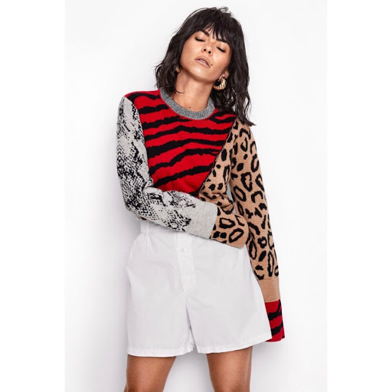
My favorite Romanian singer : INNA
Elena Alexandra Apostoleanu, known as INNA is a Romanian singer and songwriter. She was born in 1986 in Mangalia and raised in Neptun. Singing style: pop-rock.

Slide 7


