Slide 1

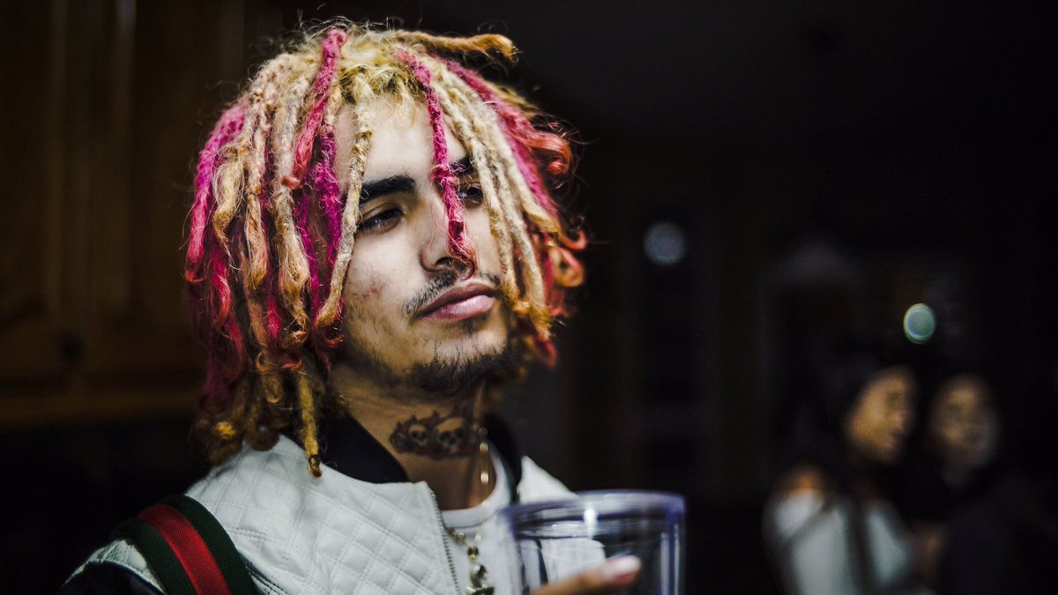
Lil pump Rap
Kipras Černauskas
The music I like

Slide 2
Rap
Formed in – 1950-1970
Old school rap is slow new rap is very fast
Fastest rapper is Rebel XD's he can rap 683 syllables in 54,5 seconds

Slide 3
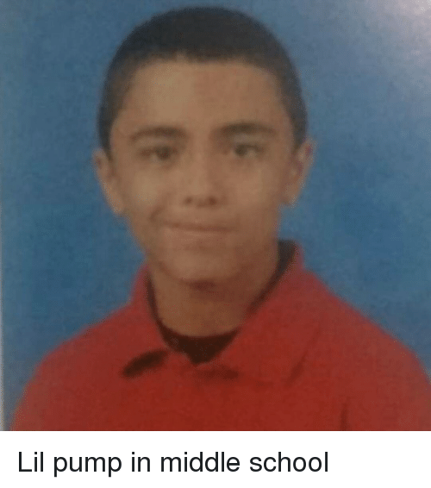
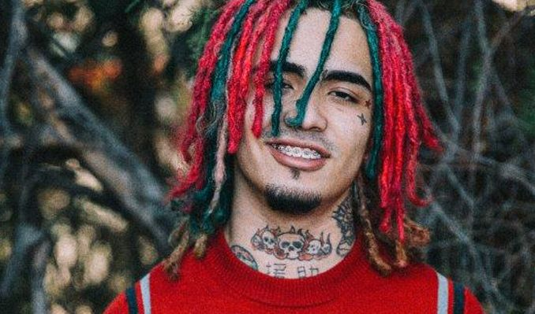
Lil pump
Was born in August 17, 2000. Now he is 19
His real name is Gazzy Garcia
-------->

Slide 4
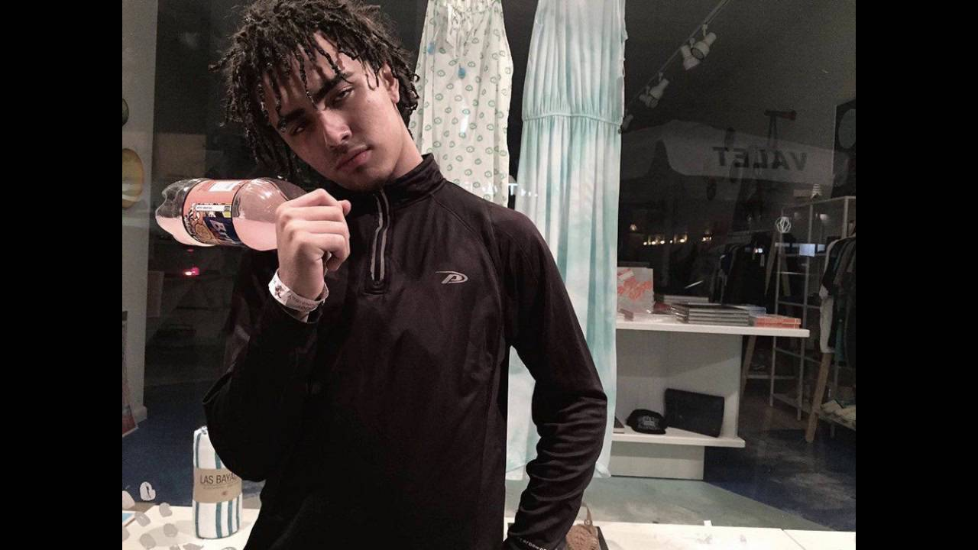
Career begin In (2016)
Garcia's rapping career began when Smokepurpp (His friend) produced a track and asked Garcia to freestyle over it

Slide 5
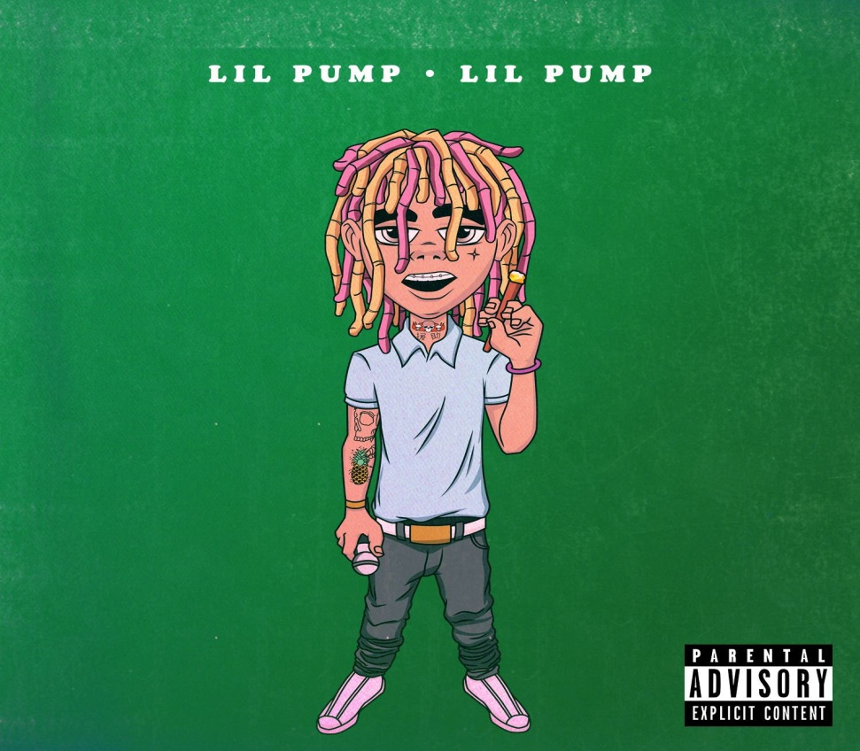
Lil pump 1 song
First song was - Lil pump
Over 31 mln views

Slide 6
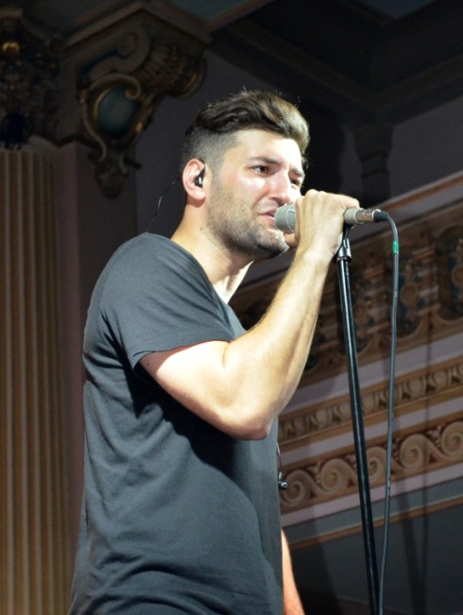
Smiley
Was born in July 27, 1983. Now he is 36.
He’s real name is Andrei Tiberiu Maria

Slide 7
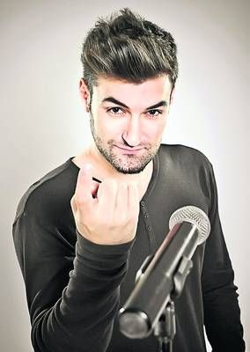
SMILEY
In 2013, he won
"Best Romanian Act„
during the MTV Europe Music
Awards held in Amsterdam
He is also part of the
Romanian Euro-House
project Radio Killer where
he is known as Killer.

Slide 8


