Slide 1
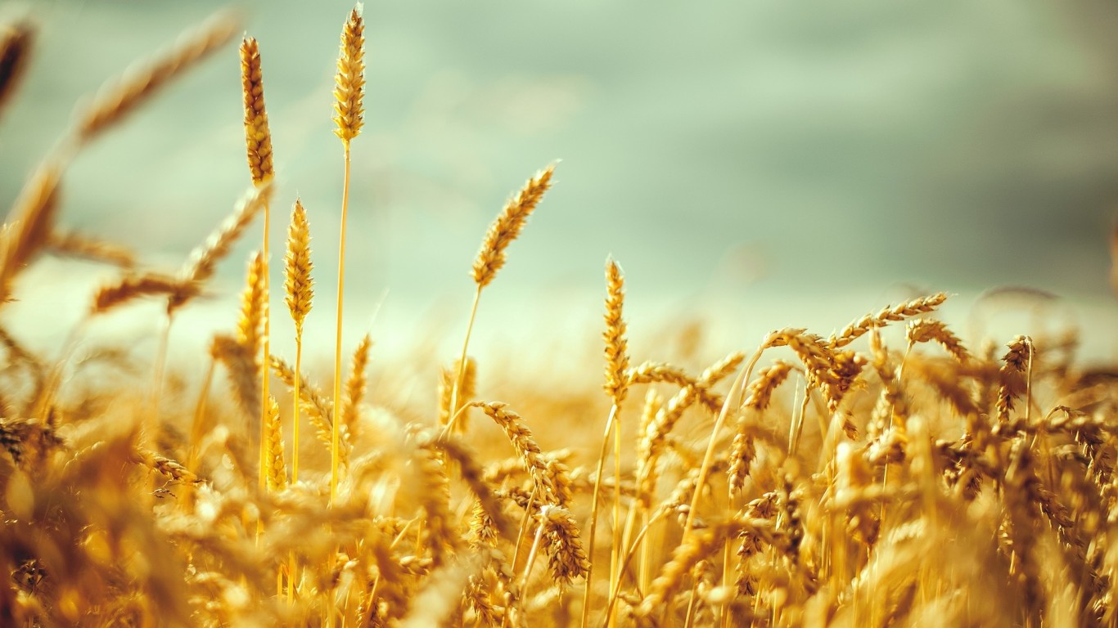
FROM
A GRAIN
TO
A LOAF

Slide 2
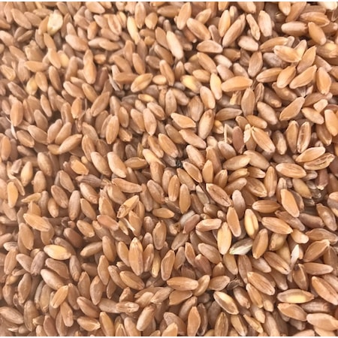
WHEAT / RYE / CORN
GRAINS

Slide 3
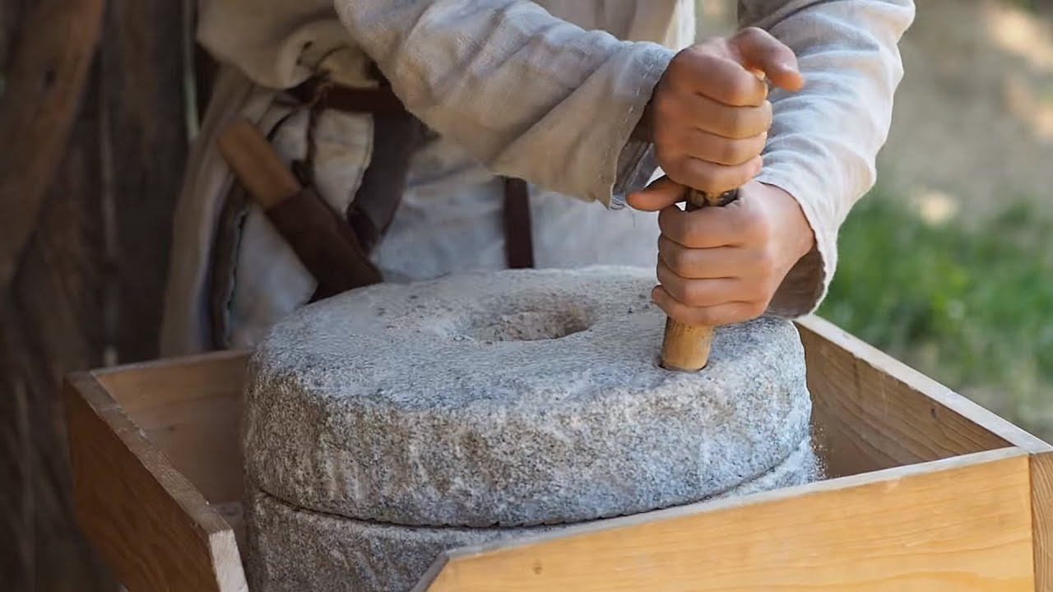
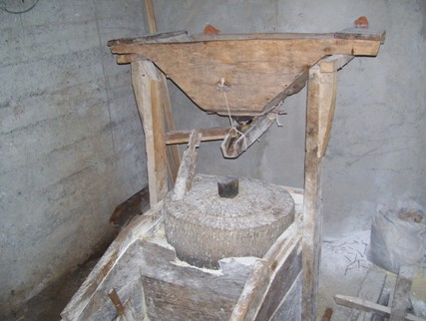
STONE MILLS / ANCIENT but STILL USED
BECOMING A FLOUR

Slide 4
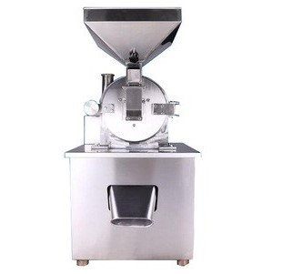
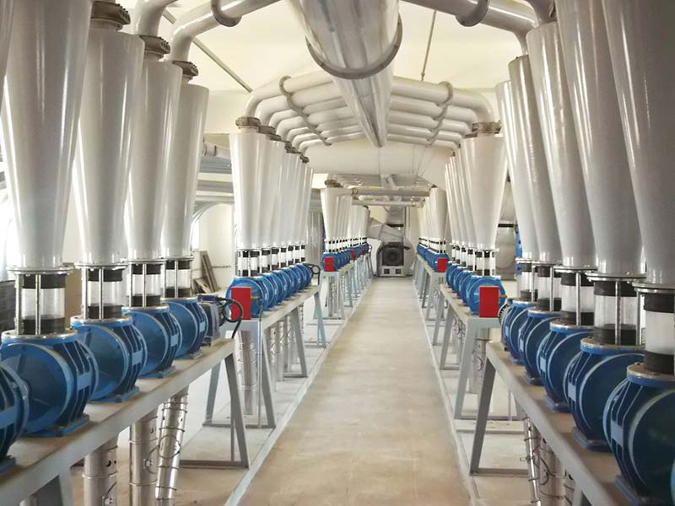
INDUSTRIAL MILLS
BECOMING A FLOUR

Slide 5
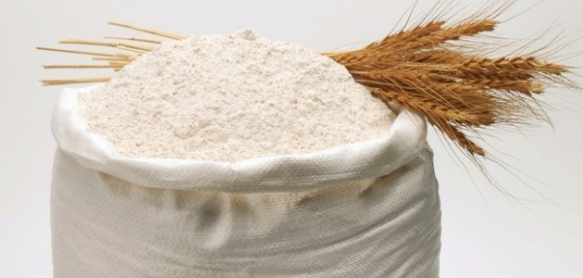
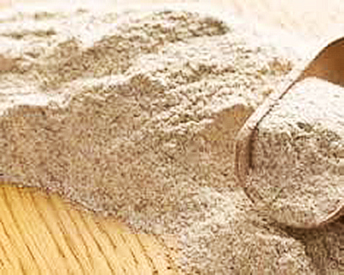
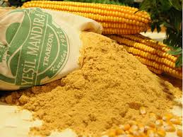
WHEAT / RYE / CORN
FLOUR

Slide 6

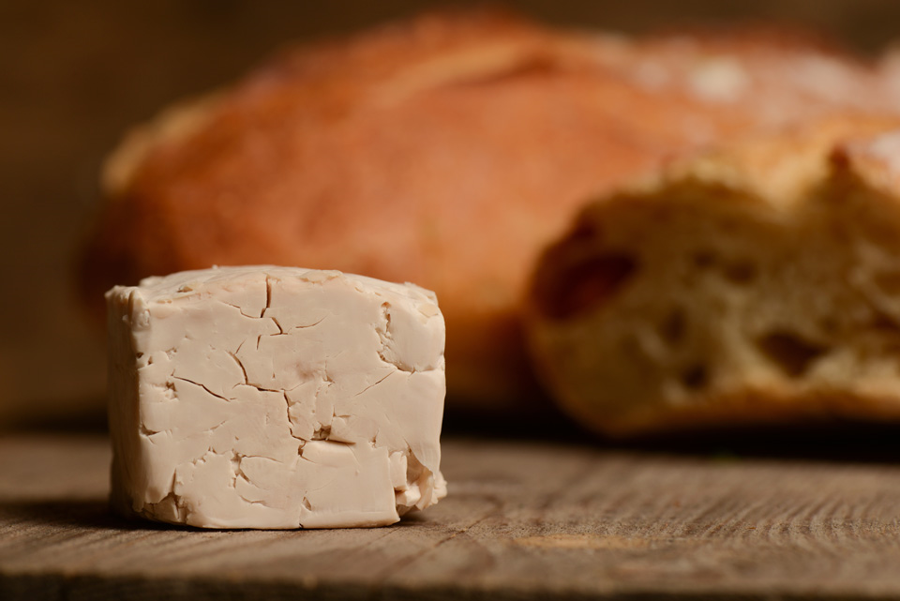
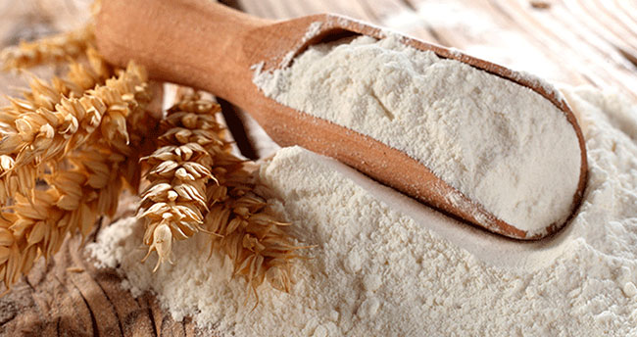
WATER / YEAST / FLOUR

Slide 7
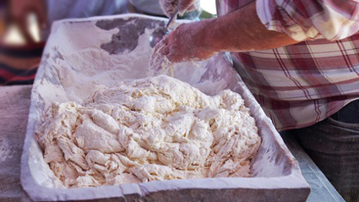
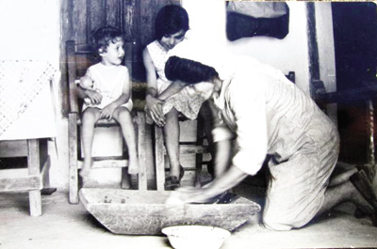
OLD STYLE KNEADING TROUGH / STILL USED
BECOMING A DOUGH

Slide 8
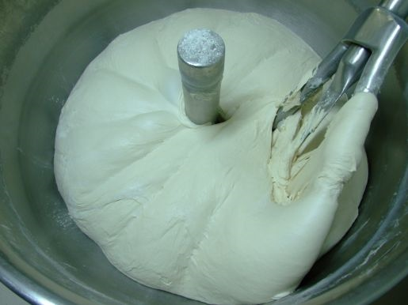
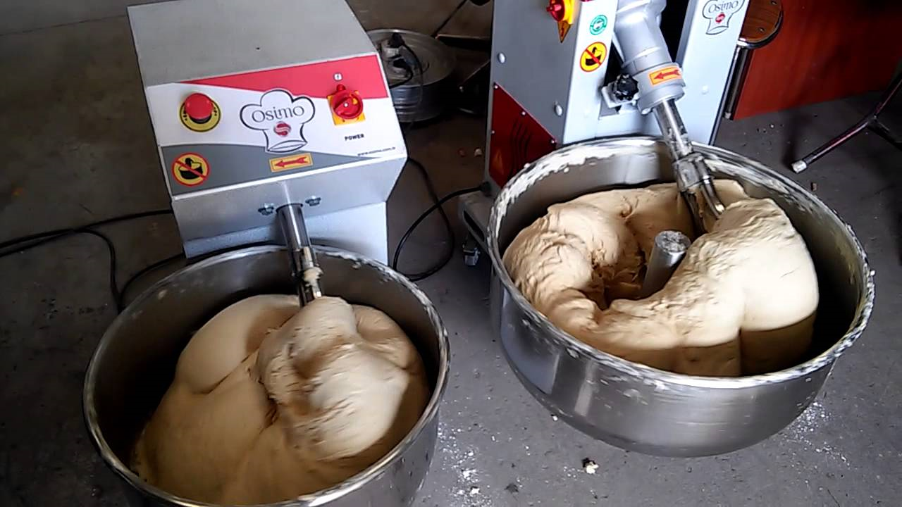
INDUSTRIAL DOUGH KNEADING
BECOMING A DOUGH

Slide 9
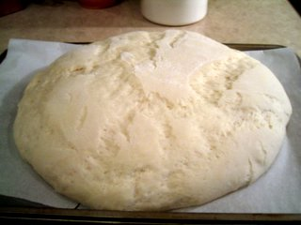
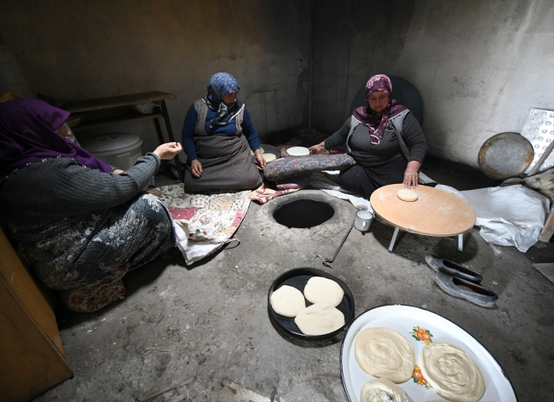
TRADITIONAL VILLAGE STYLE
SHAPING A BREAD

Slide 10
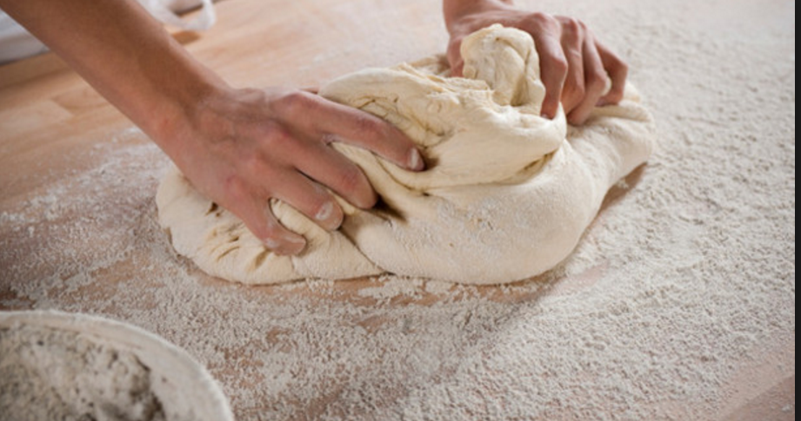
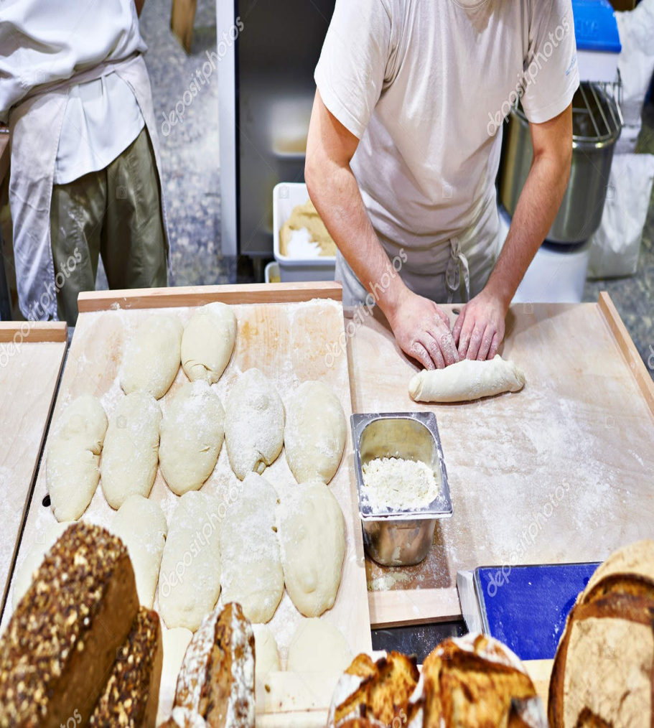
TRADITIONAL BAKERY
SHAPING A BREAD

Slide 11
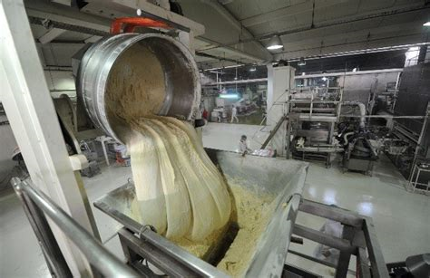
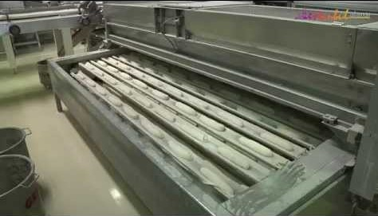
INDUSTRIAL SHAPING
SHAPING A BREAD

Slide 12
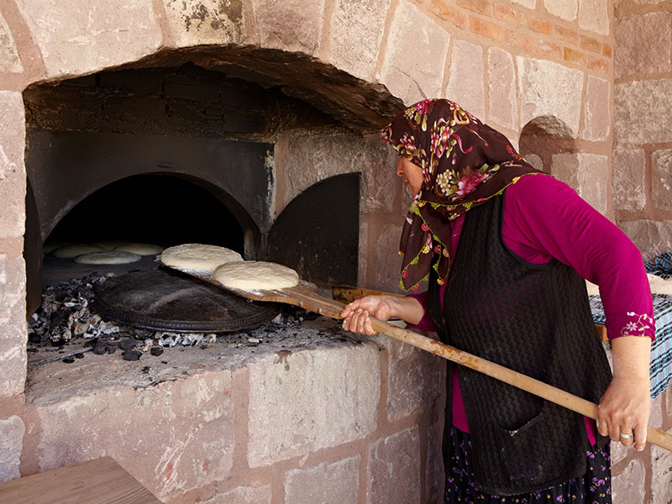
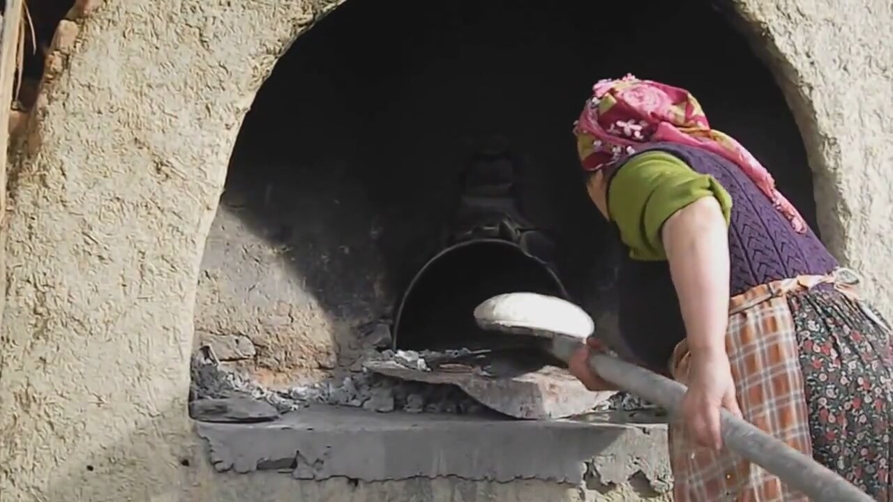
TRADITIONAL BAKING / STILL USED
BAKING A BREAD

Slide 13
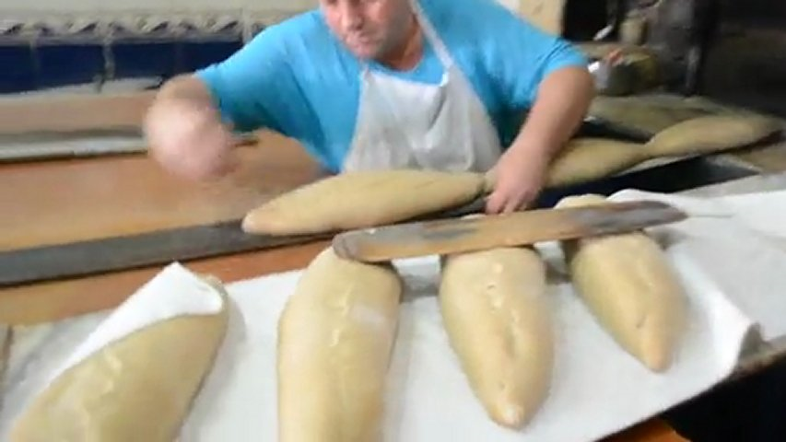
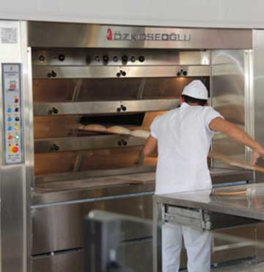
BAKERY BAKING
BAKING A BREAD

Slide 14
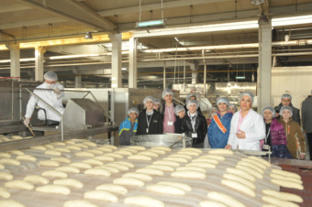
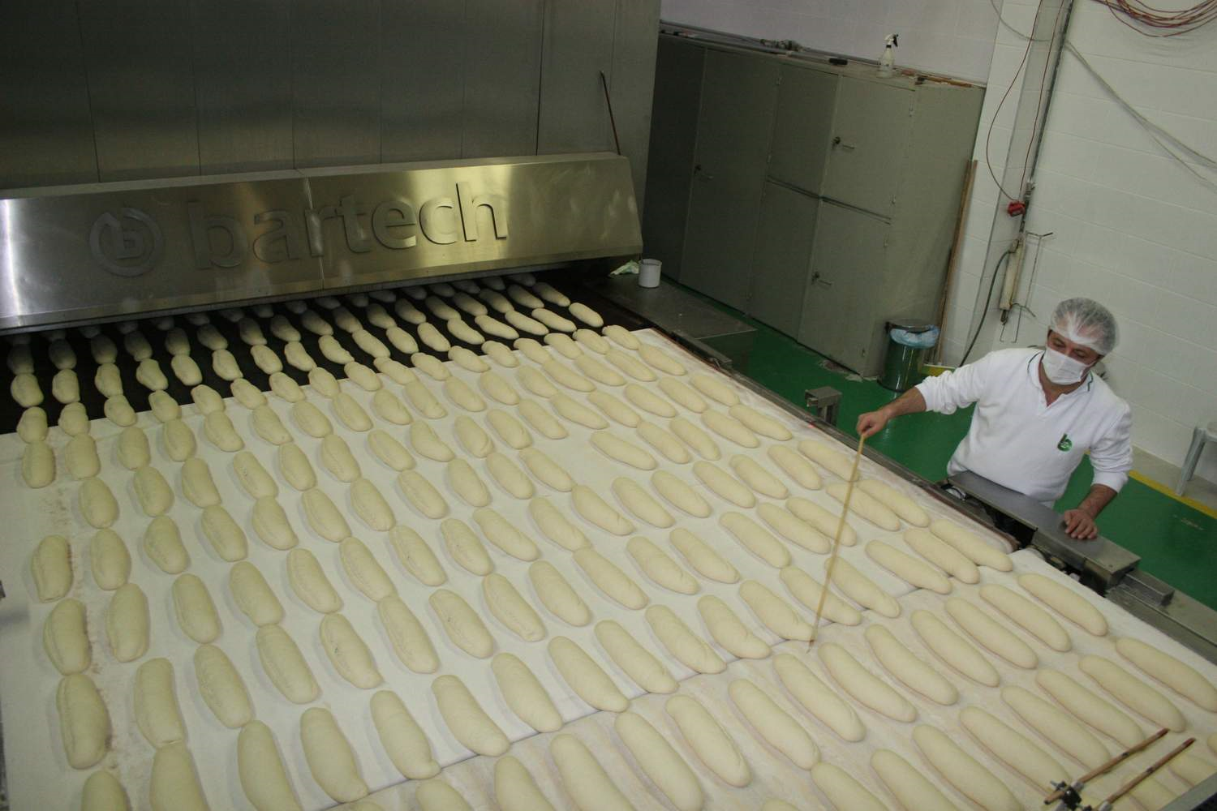
INDUSTRIAL BAKING
BAKING A BREAD

Slide 15
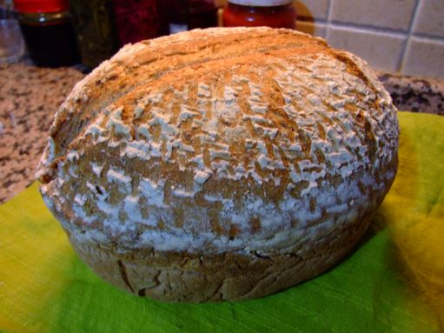
TRADITIONAL HOMEMADE
A LOAF of BREAD

Slide 16
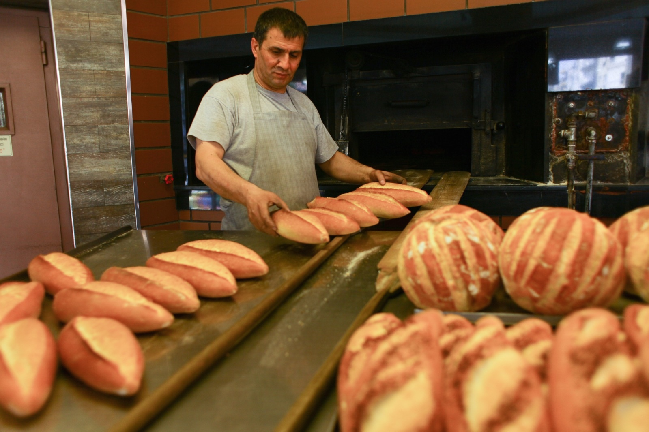
TRADITIONAL BAKERY
A LOAF of BREAD

Slide 17
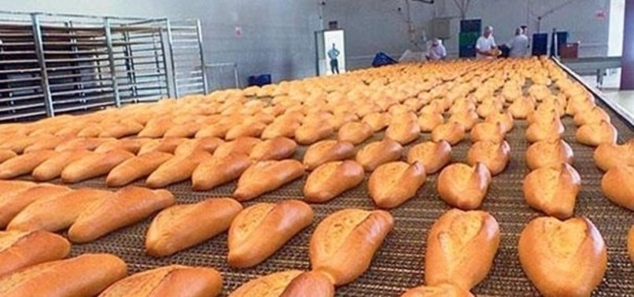
INDUSTRIAL PRODUCTION
A LOAF of BREAD

Slide 18

PREPARED BY TURKISH TEAM

